Slide 1
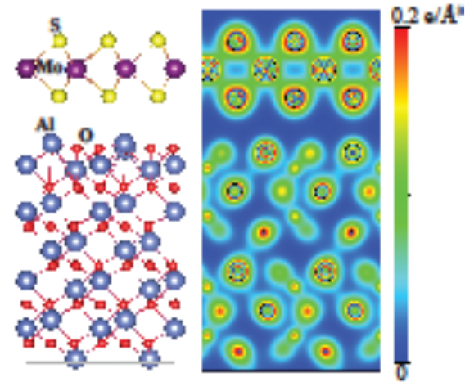
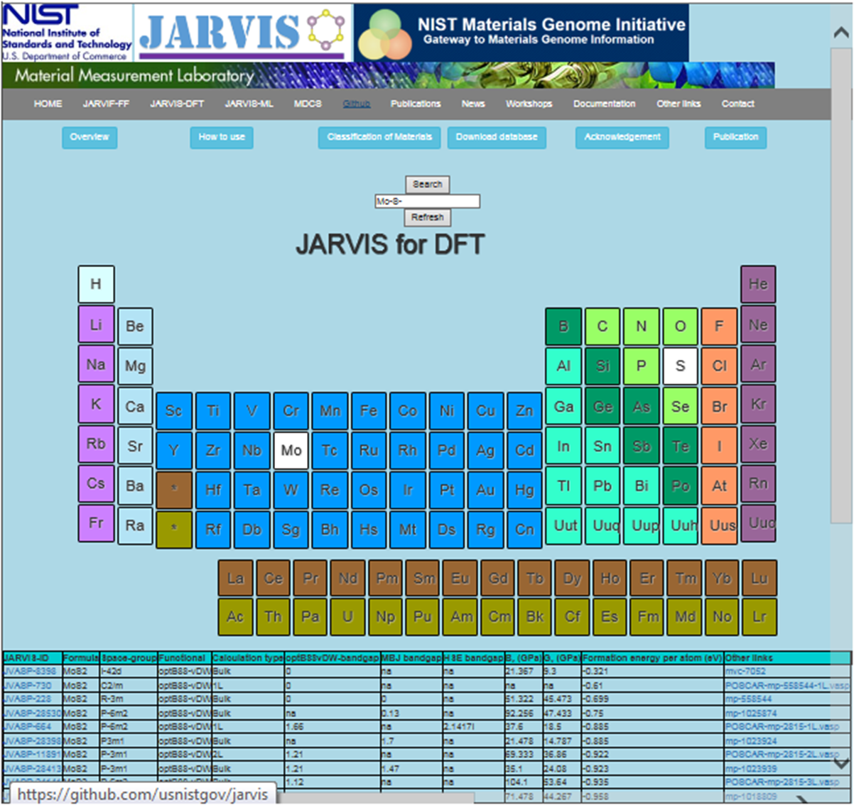

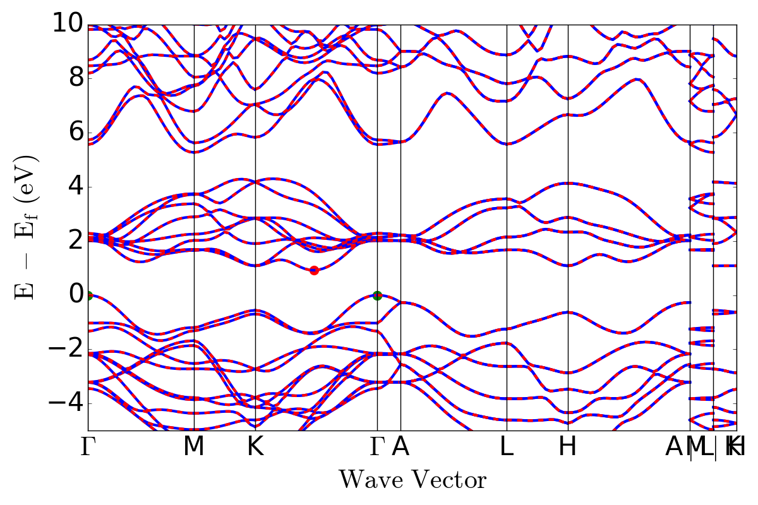


NIST DFT-related databases:
a high-throughput way to investigate material properties
F. Tavazza, K. Choudhary
National Institute of Standard and Technology

Slide 2
Collaborators
JARVIS-FF
JARVIS-DFT
C. Becker (NIST)
L. Hale (NIST)
R. G. Hennig (UFL)
T. Liang (Penn State)
Y. Congo (NIST)
G. Cheon (Stanford)
E. Reed (Stanford)
Y. Congo (NIST)
Qin Zhang (NIST)
Sugata Chowdhury (NIST)
Kevin Garrity (NIST
JARVIS-ML
DFT Benchmarking
B. DeCost (NIST)
J. Gabriel (UFL)
R. G. Hennig (UFL)
Y. Congo (NIST)
T. Allison (NIST)

Slide 3

Motivations
Why databases?
They provide:
easy access to material properties/modeling aids to user community
large and consistent data sets for trend search and statistical property analysis
Inspiration and validation for screening criteria to aid new material search
Scripts and tools to the user community to compute physical quantities similar to those already posted in the database

Slide 4
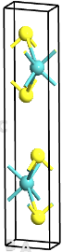
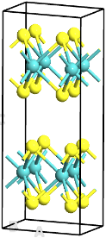
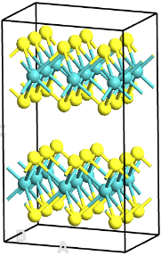
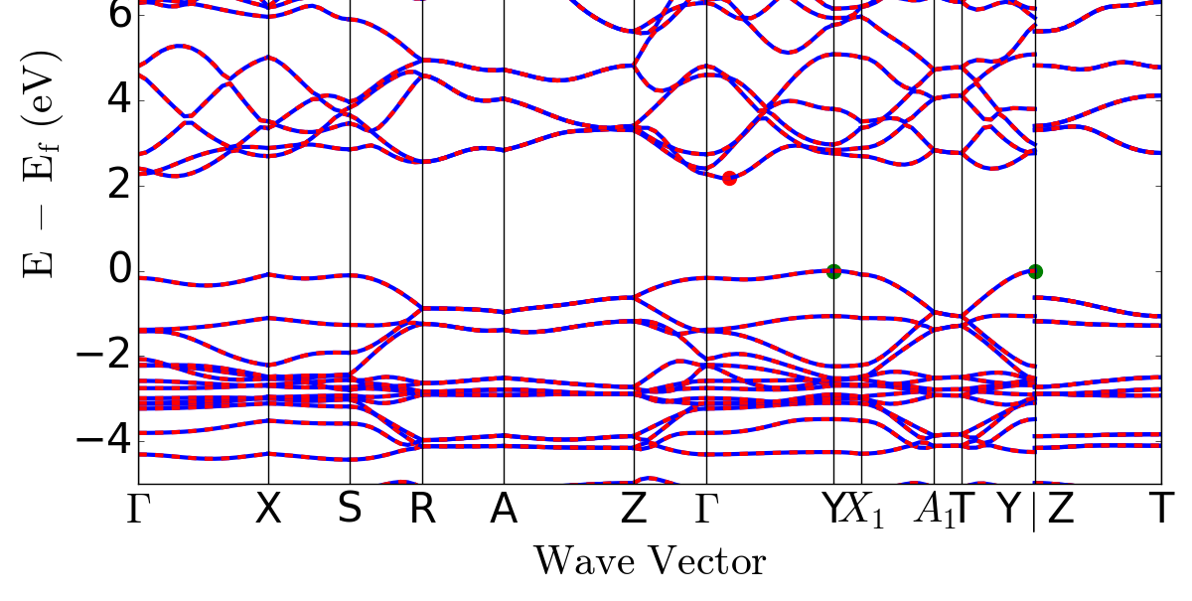
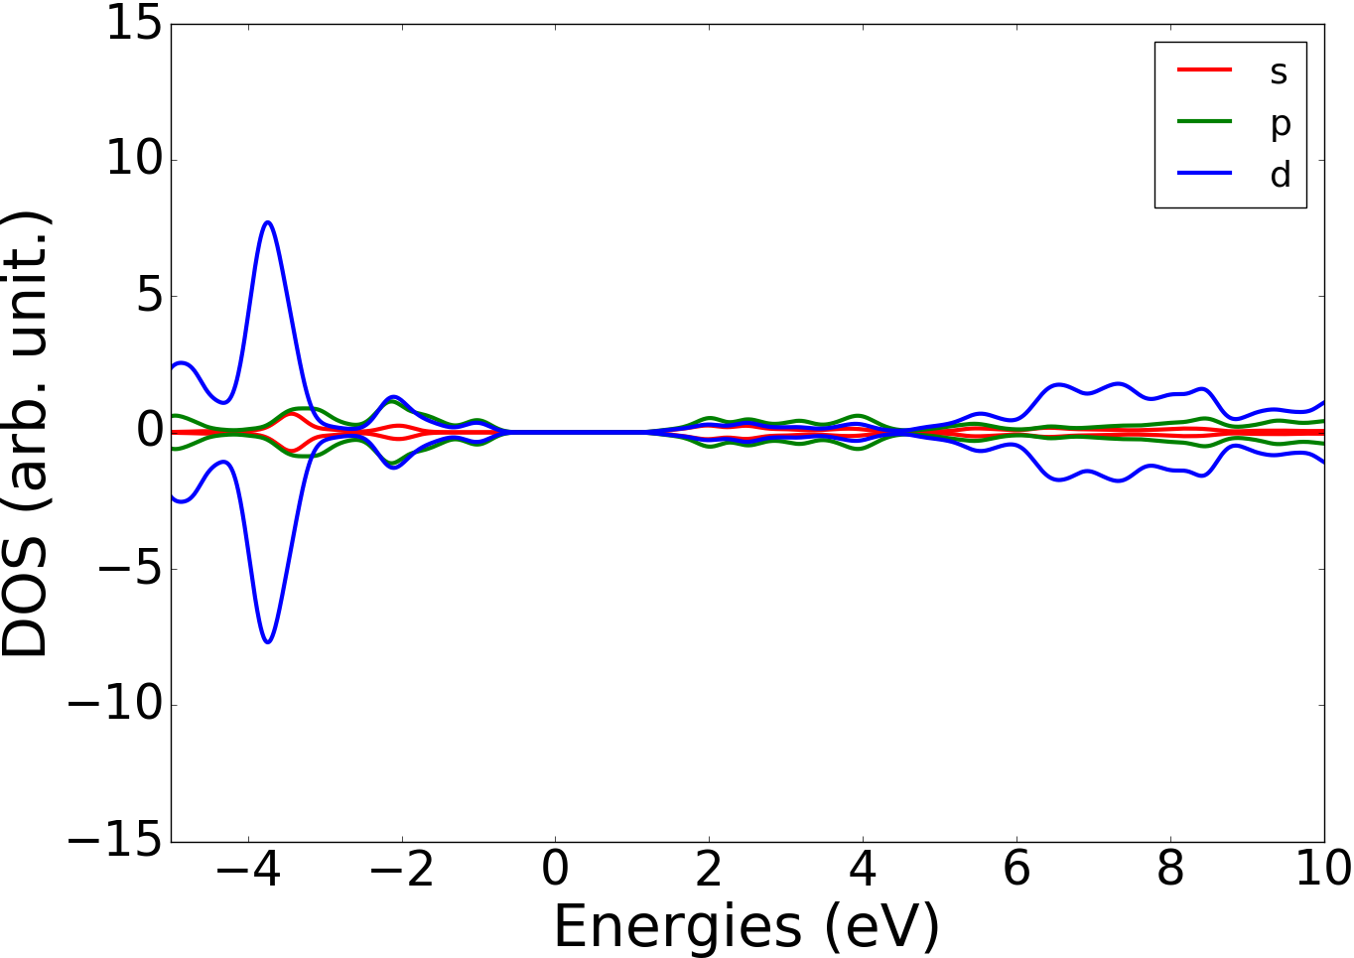
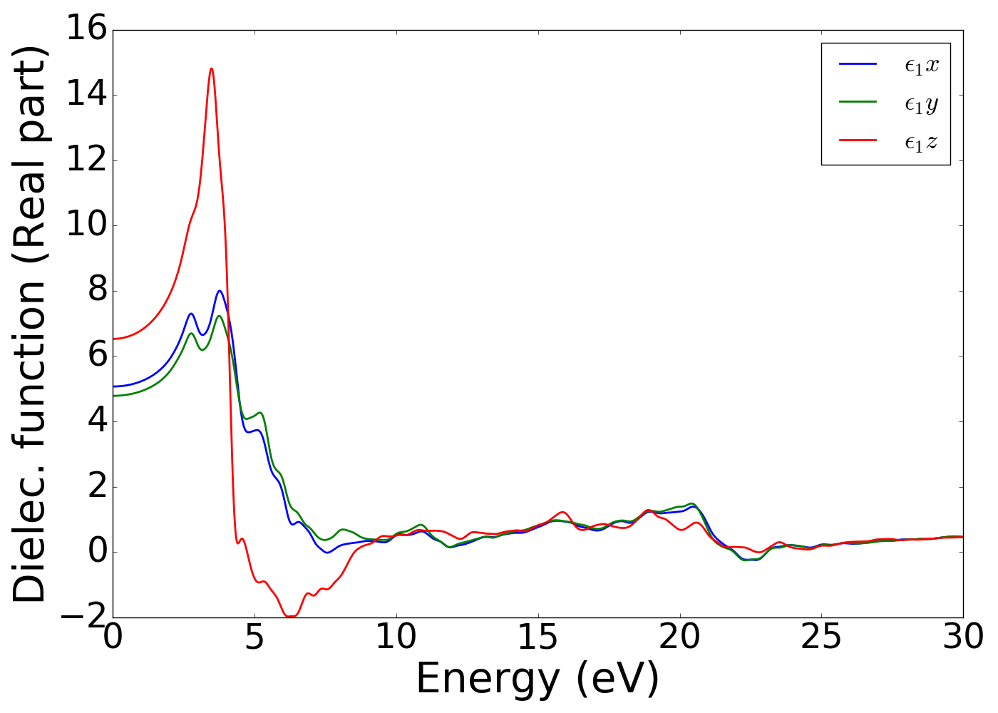
Density Functional Theory (DFT)
Atomistic modeling
Based on quantum-mechanics (treats electrons)
Advantages/Disadvantages
Excellent predictive power in solids
Very few fitting parameters ➔ very transferable
Very computationally costly:
  small systems (hundreds of atoms at most)
  very short times (MD, semistatic deformations)
Allows the exploration of:
- Energetics
Mechanical properties (elastic constants, phonons, etc.)
Electronic properties (Band structure, E_{g}, DOS, etc.)
Optical properties (Dielectric function, Absorption coeff., etc.)
Thermoelectric properties
….

Slide 5
Time-independent, many-particle Schrödinger eq.: Ĥ Ψ = E Ψ
intractable!
DFT: the ground state (GS) energy of a molecule/crystal can be determined from the electron density (3 d.o.f.) instead of a wave function (3N d.o.f., N= # of electrons)
Kohn-Sham
theorem
energy functional of a system of interacting electrons:
E [ρ] = T [ρ] + V_{ext}[ρ] + V_{ee}[ρ]
fictitious system of N non-interacting electrons moving in an effective potential with density = to the true density
untreatable!
E [ρ] = T_{s}[ρ] + V_{ext}[ρ] + V_{Coulomb}[ρ] + E_{xc}[ρ]
E_{xc} not known exactly and contains all the many-body quantum effects
Variational problem: because E= E[ρ] and ρ is unknown, the minimization of E(ρ) is performed self-consistently (SCF)
Parameters!
Ground state energy is calculated as numerical integral over reciprocal space
Parameters (kpoints)!

Slide 6
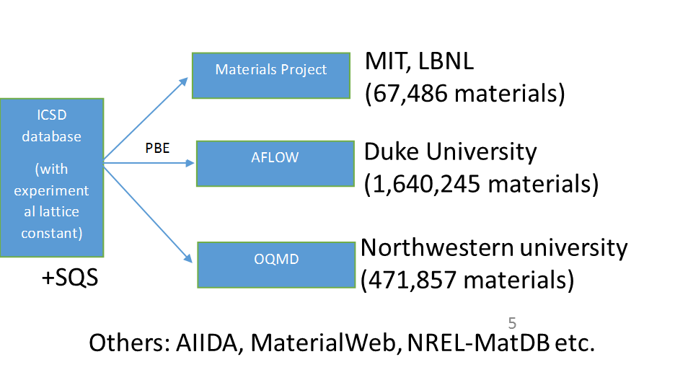
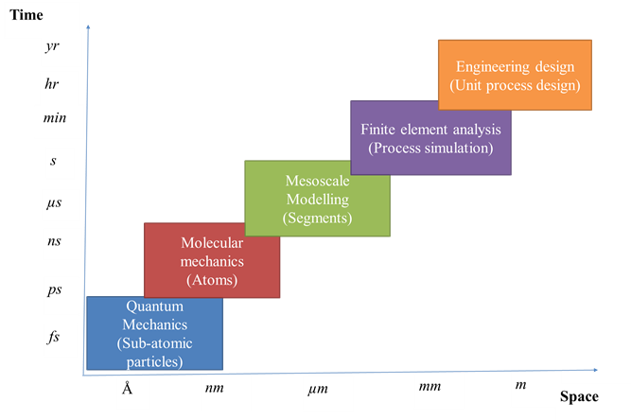
NIST DFT Databases
Several currently available databases in computational solid state material science (DFT-based).
NIST databases are complimentary to those already out there:
  Quantum (DFT) calculations
  Classical calculations (Force fields)
  Repository of machine learning (ML) parameters
JARVIS-DFT
JARVIS-ML
DFT Benchmarking
HT identification, characterization of technologically relevant materials (low dimensional, solar cell, etc.)
ML predictions of material properties using chemical and classical force-field inspired descriptors
Uncertainty Quantification for DFT calculations: effects of parameters choices (kp, smearing, etc.)

Slide 7
JARVIS-DFT
Density Functional (DFT) database for 0D, 1D, 2D, 3D, Solar-cell and Thermoelectric materials
The JARVIS-DFT consists of more than 25,000 materials with more than 100,000 property calculations. We have Energetics (heat of formation and exfoliation energies), Structural properties (diffraction pattern, radial distribution function), Electronic properties (band-structure, density of states, conventional and improved DFT bandgaps), Transport properties (carrier effective mass, Seebeck coefficient), temperature and carrier concentration dependent thermoelectric properties, Elastic constants and gamma-point phonons and dielectric functions.
- It contains 2D-layered and 2D-bulk and 3D-bulk structures – 1D and 0D about to be added
- OptB88vDW functional ( better for 2D materials than PBE)
- Optimized energy cut-off and K-point sampling
- Made with custom-modification of publicly available Pymatgen, Phonopy, ASE tools.
- All data available for download, all scripts available on github (https://github.com/usnistgov/Jarvis).
Notes:
VASP: PAW pseudopotentials
Generally the PAW potentials are more accurate than the ultra-soft pseudopotentials. There are two reasons for this: first, the radial cutoffs (core radii) are smaller than the radii used for the US pseudopotentials, and second the PAW potentials reconstruct the exact valence wavefunction with all nodes in the core region. Since the core radii of the PAW potentials are smaller, the required energy cutoffs and basis sets are also somewhat larger. If such a high precision is not required, the older US-PP can be used. In practice, however, the increase in the basis set size will be usually small, since the energy cutoffs have not changed appreciably for C, N and O, so that calculations for model structures that include any of these elements are not more expensive with PAW than with US-PP.

Slide 8
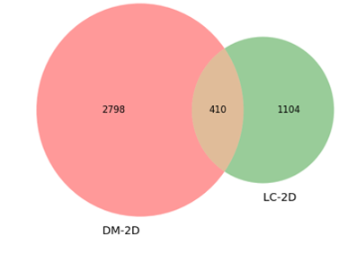
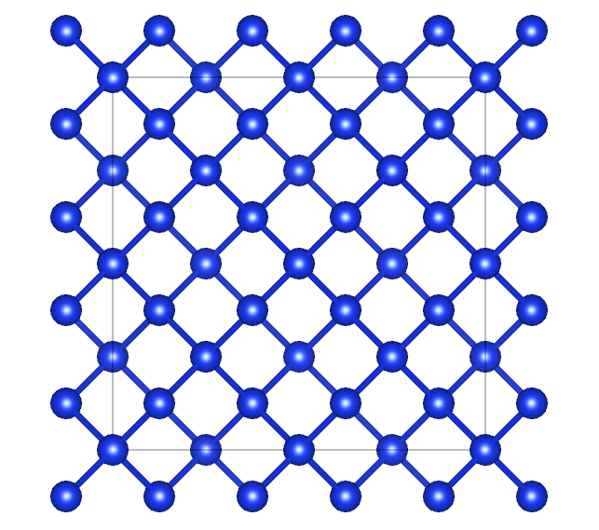
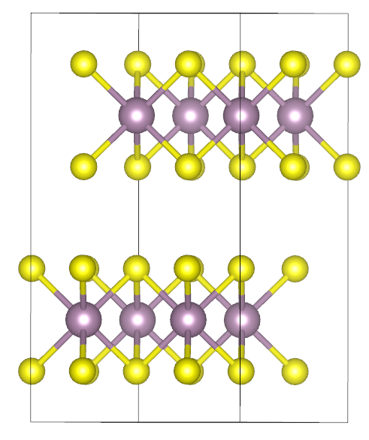
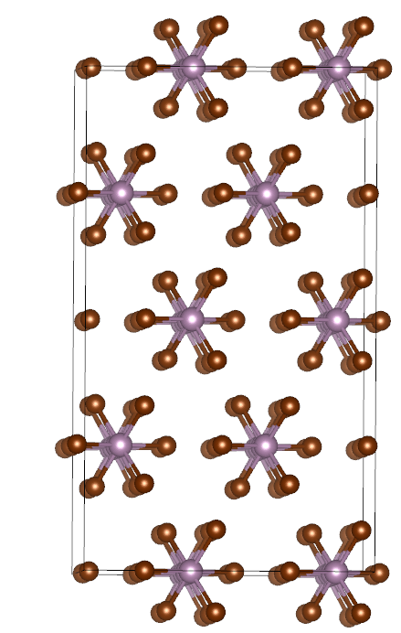
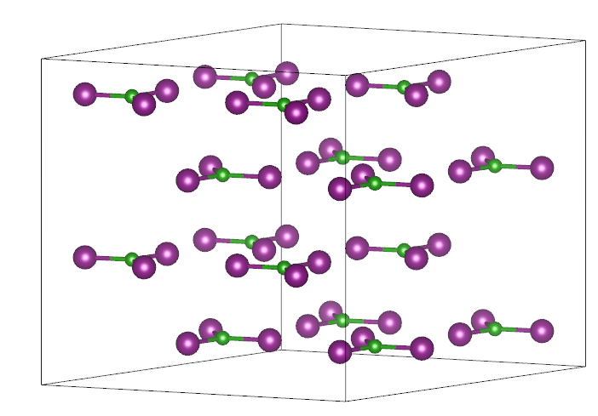
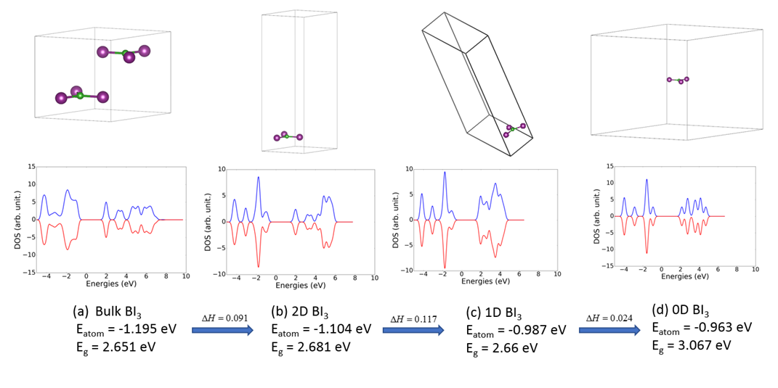
3D, 2D, 1D, 0D materials
3D: Si
2D: MoS₂
1D-MoBr₃
0D: BiI₃
Van der Waals bonding in x and/or y and/or z-directions
Dimension/ # materials | Lattice constant approach | Data-mining approach
0D | 792 | 2169
1D | 1575 | 549
2D | 1514 | 3208
More than 6000 low-D materials!
Molecule like peaks
Choudhary et al., Nature: Scientific Reports, 7, 5179 (2017)

Slide 9
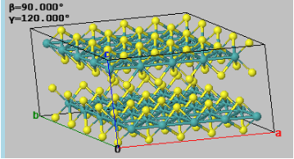
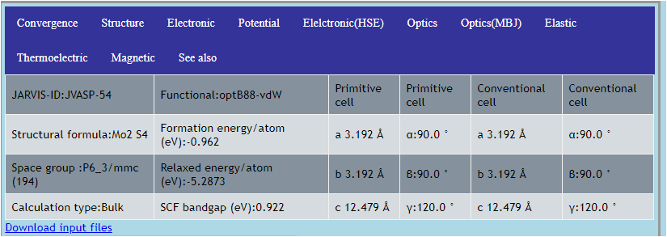
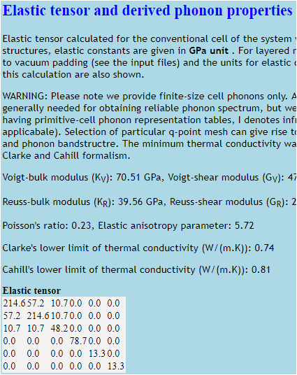
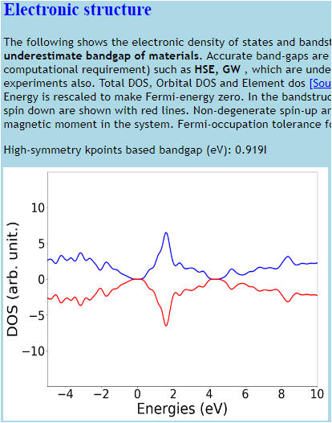
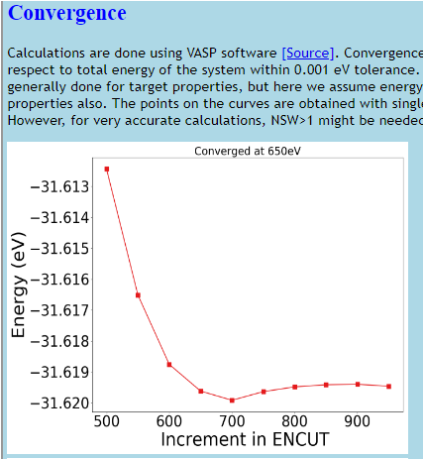
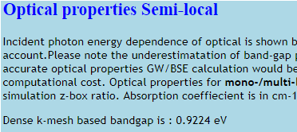

JARVIS-DFT
Energy Gap
Bulk Modulus
Shear Modulus

Slide 10
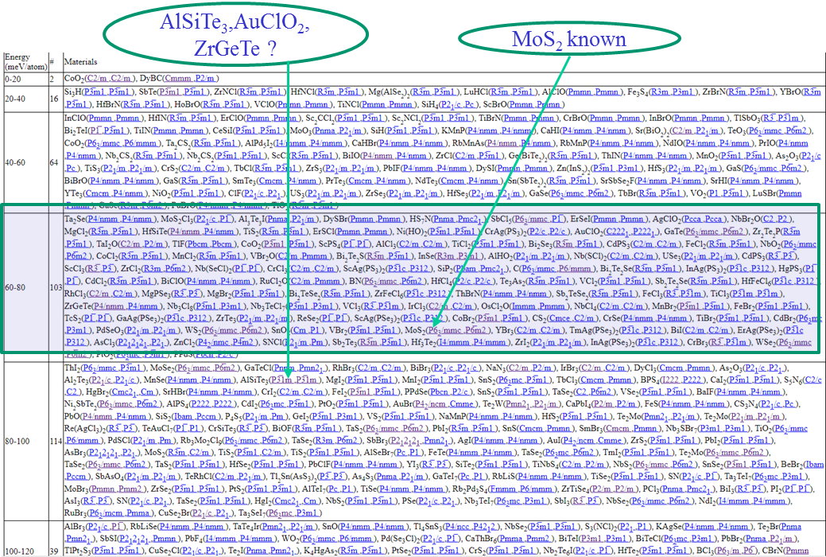
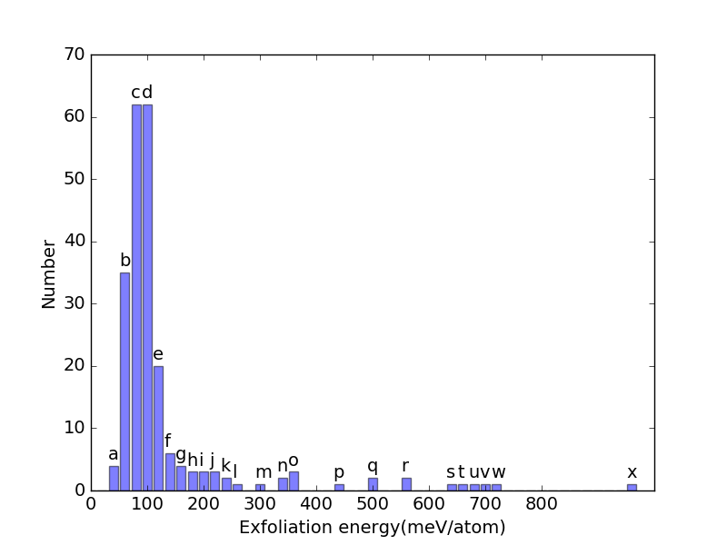

JARVIS-DFT: examples of Postprocessing
A) 2D prediction (Exfoliation energy calculations)
Conventional criteria:
E_{f} <= 200 meV/atom

Slide 11
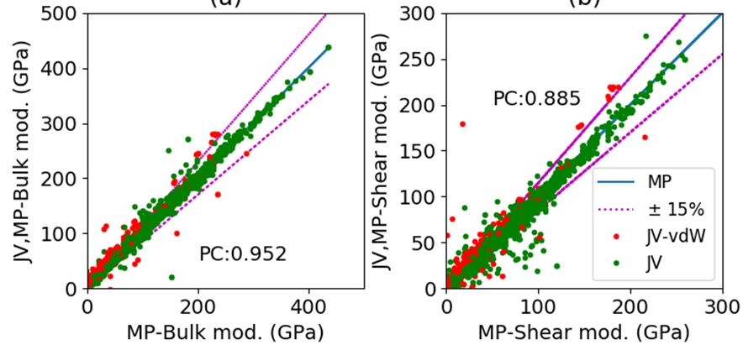
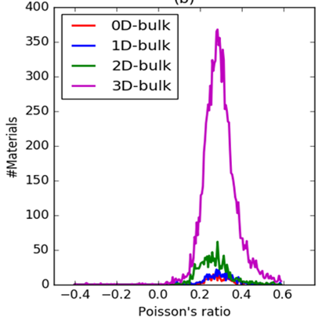
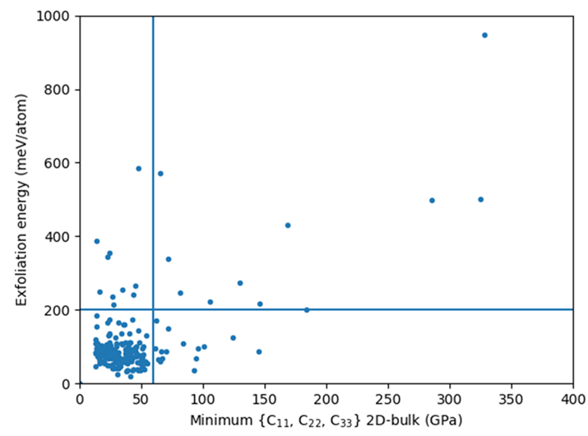
B) Mechanical properties
Comparison of JARVIS-DFT OPT data with MP PBE data
Note: All 3D calculations

Slide 12
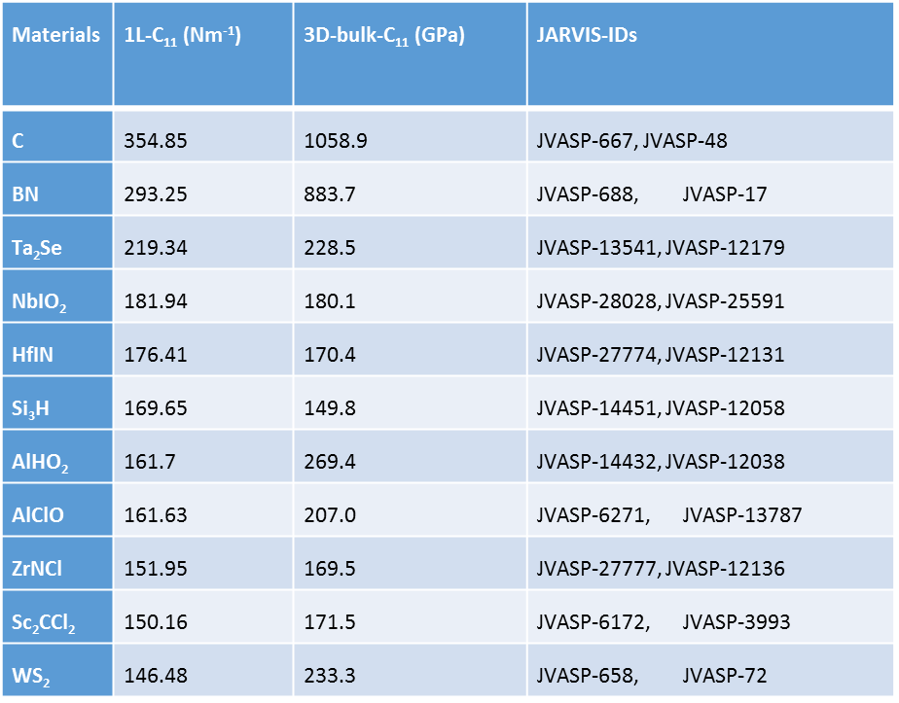
Mechanical properties: Trends Bulk vs 2D
NOT
the same
ranking!!

Slide 13
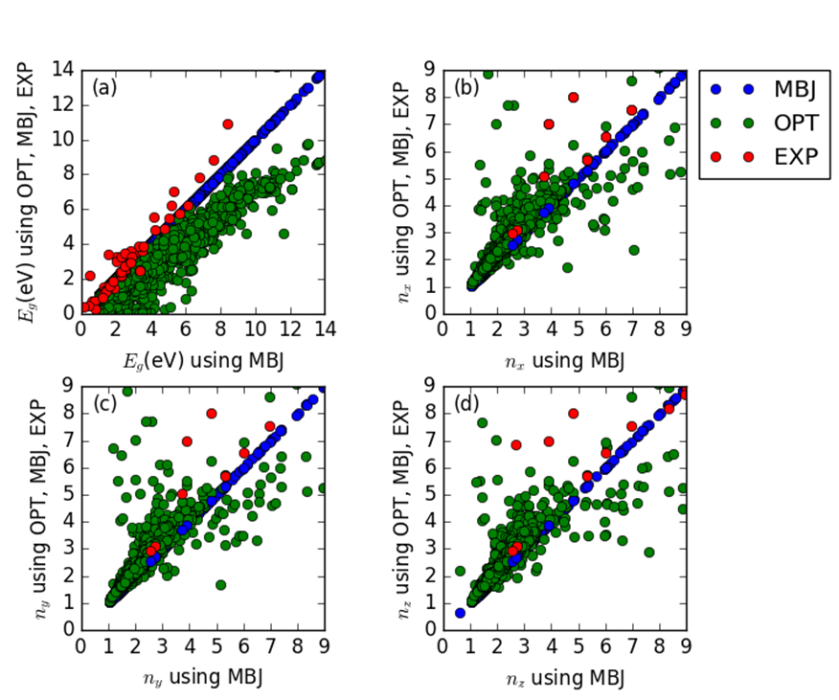
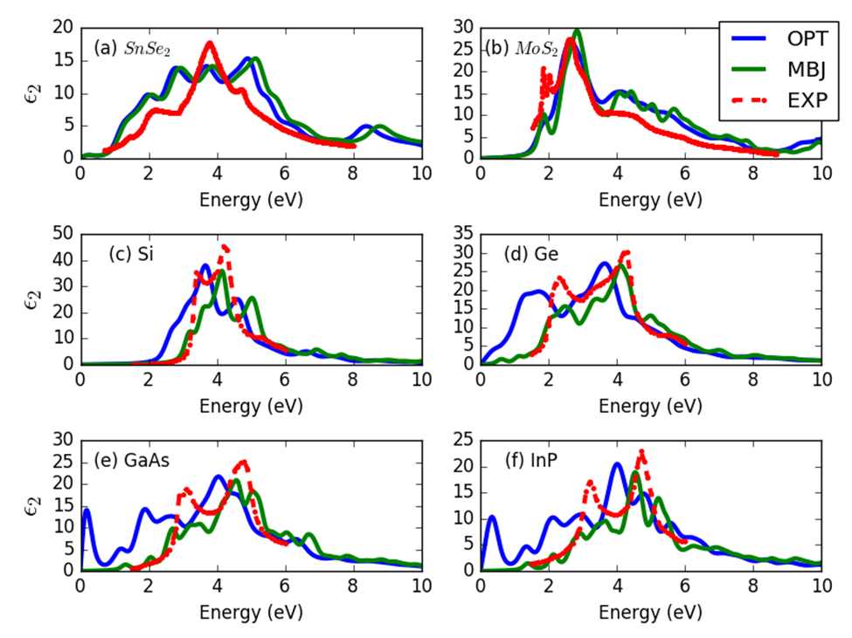
C) Optoelectronic properties
Bandgap, frequency dependent dielectric function from OptB88vdW (OPT) and Modified Becke-Johnson formalisms (MBJ)
MBJ gives excellent bandgap with low computational cost
Example of Validation
Accepted, ScientificData

Slide 14
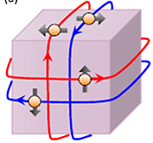
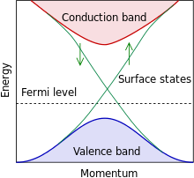
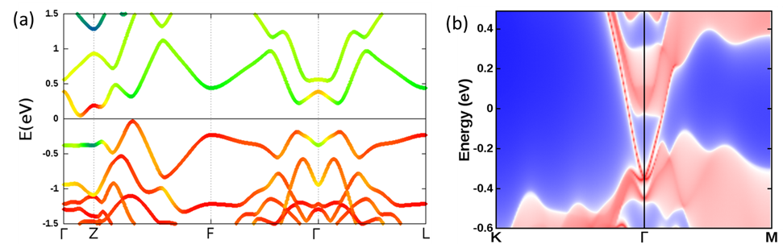
D) Search for topological insulators (TI)
TI: insulator in its interior but its surface contains conducting states
Applications: quantum computing, low-power spintronic
Spin-orbit DFT calculations, subsequent Wannier90 based tight-binding Hamiltonian
Calculation of Z₂ index and Chern number
We found several novel topological insulators such as Bi₂TeI
Source code for high-throghput Z2 calculation will be available soon on our github
COMING SOON on JARVIS-DFT
Unpublished
(a) The bulk band structure of Bi2PbSe4 including spin-orbit. (b) Energy and momentum dependence of local density of states (LDOS) of Bi2PbSe4 along the (001) surface at Г point.
Notes:
Behaves as an insulator in its interior but its surface contains conducting states(i.e. electrons can only move along the surface of the material)

Slide 15
JARVIS-ML
Physics inspired AI for fast and accurate screening of materials
10¹⁰⁰ materials predicted ➔ TOO MANY to characterize with current
theoretical and experimental techniques
AI in materials
For successful application of AI:
  High fidelity data, pertinent algorithm and validation strategy
Unlike other AI input data (cat/dog images etc.), materials data are really small and take long time to generate
Availability of easily applied AI algorithms: scikit-learn, tensor-flow, etc.
Publicly available databases such as JARVIS-DFT, Materials-project, AFLOW, OQMD, Harvard clean energy project, AiiDA, PDB database, COD database etc.

Slide 16
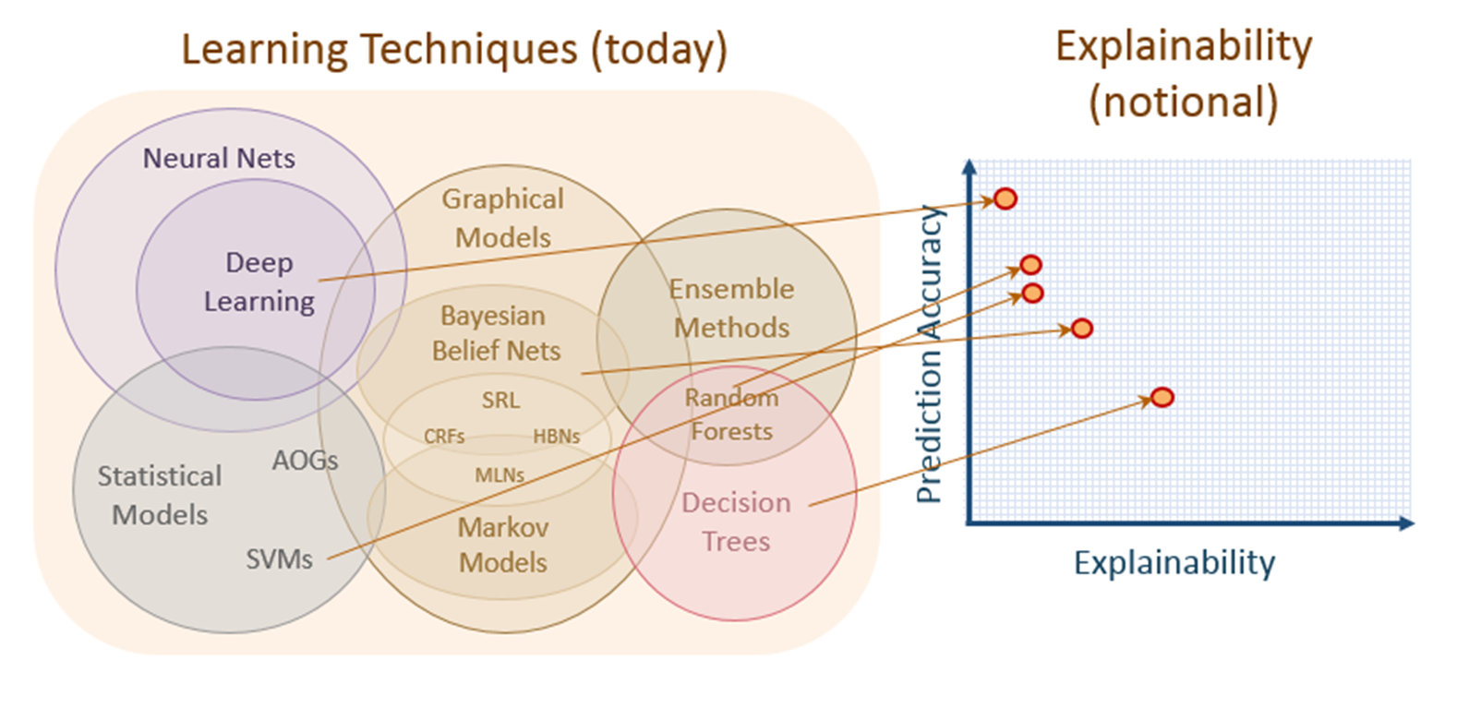
Steps in JARVIS-ML model
1) Descriptor selection (perhaps the most important step!)
2) Preprocessing (variance threshold, PCA etc.)
3) Train-test split of data (90%-10% for instance)
4) Hyperparameter optimization using grid-search on train data
5) Select the best model (based on R²/MAE/RMSE accuracy)
6) Prediction on test data (classification/regression)
7) Plot learning curve for complexity analysis
8) Plot feature importance (if available)
Gradient boosting decision tree (GBDT)

Slide 17
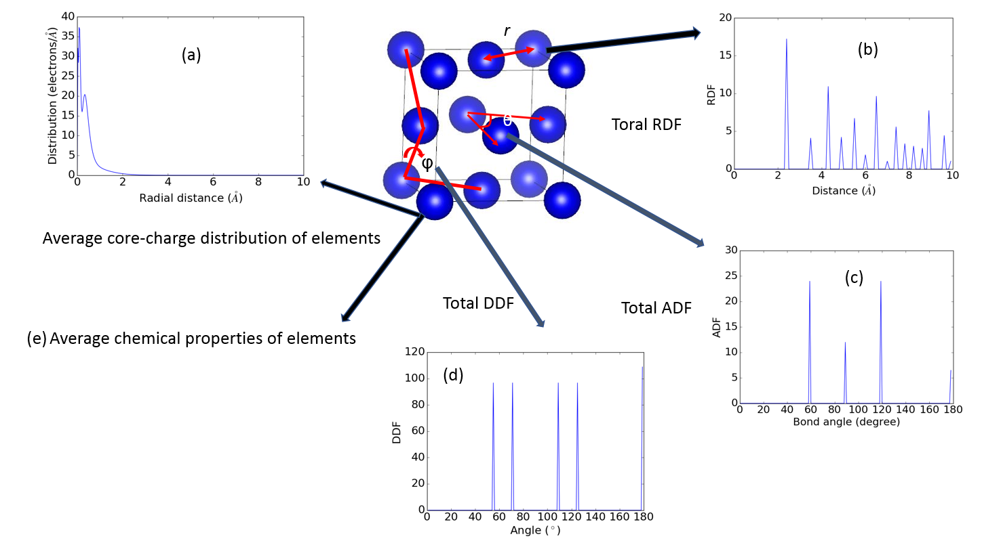
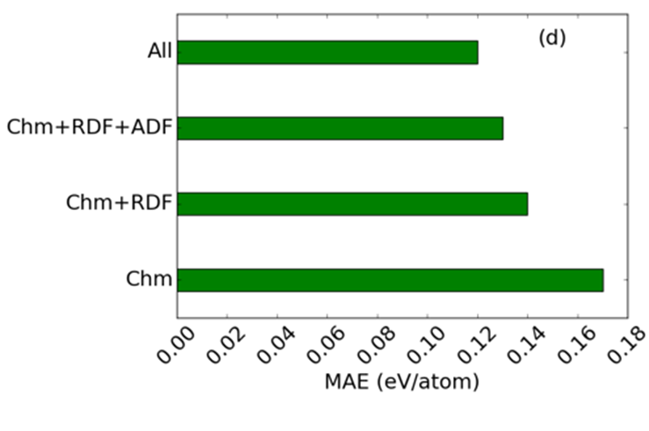
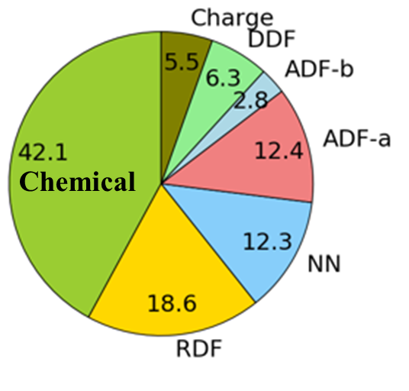
Finding the right descriptors: representing atomic structure to computers
Explainability!
Chemical features most important followed by RDF and NN
Incrementally adding structural features decreases MAE
1557 descriptors for one material
https://github.com/usnistgov/jarvis

Slide 18
Model performance
Property | #Data-points | MAE_{CFID-DFT} | MAE_{DFT-Exp}
Formation energy (eV/atom) | 24549 | 0.12 | 0.136 [13]
Exfoliation energy (meV/atom) | 616 | 37.3 | -
OPT-bandgap (eV) | 22404 | 0.32 | 1.33 [21]
MBJ-bandgap (eV) | 10499 | 0.44 | 0.51 [21]
Bulk modulus (GPa) | 10954 | 10.5 | 10.0 [22,28]
Shear modulus (GPa) | 10954 | 9.5 | 10.0 [22,28]
OPT-n_{x} (no unit) | 12299 | 0.54 | 1.78 [21]
OPT-n_{y} (no unit) | 12299 | 0.55 | -
OPT-n_{z} (no unit) | 12299 | 0.55 | -
MBJ-n_{x} (no unit) | 6628 | 0.45 | 1.6 [21]
MBJ-n_{y} (no unit) | 6628 | 0.50 | -
MBJ-n_{z} (no unit) | 6628 | 0.46 | -
Performance on 10 % held data

Slide 19
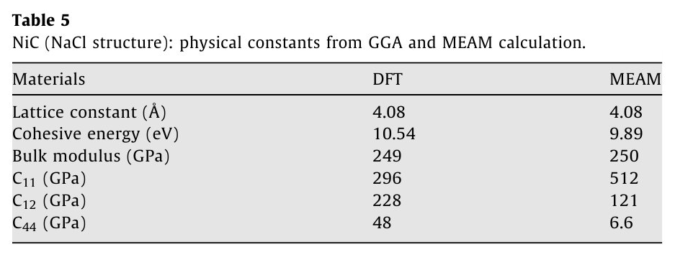
DFT Benchmarking
DFT values are used in the literature as reference values (to compare to, to fit to, etc. )
They are always reported without uncertainties
They are often reported with very few technical specifications
however
is DFT exact ?
If not, how to evaluate its uncertainties?

Slide 20
Time-independent, many-particle Schrödinger eq.: Ĥ Ψ = E Ψ
intractable!
DFT: the ground state (GS) energy of a molecule/crystal can be determined from the electron density (3 d.o.f.) instead of a wave function (3N d.o.f., N= # of electrons)
Kohn-Sham
theorem
energy functional of a system of interacting electrons:
E [ρ] = T [ρ] + V_{ext}[ρ] + V_{ee}[ρ]
fictitious system of N non-interacting electrons moving in an effective potential with density = to the true density
untreatable!
E [ρ] = T_{s}[ρ] + V_{ext}[ρ] + V_{Coulomb}[ρ] + E_{xc}[ρ]
E_{xc} not known exactly and contains all the many-body quantum effects
Parameter!
Variational problem: because E= E[ρ] and ρ is unknown, the minimization of E(ρ) is performed self-consistently (SCF)
Parameter!
Ground state energy is calculated as numerical integral over reciprocal space
Parameters (kpoints)!

Slide 21
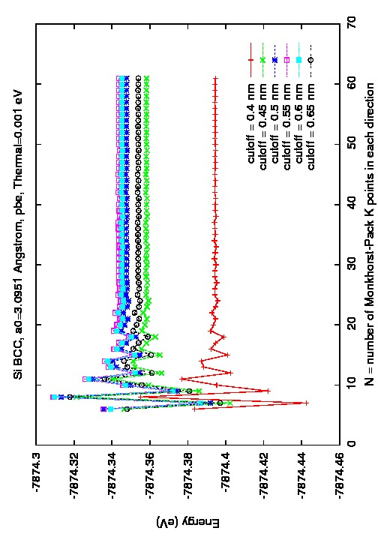
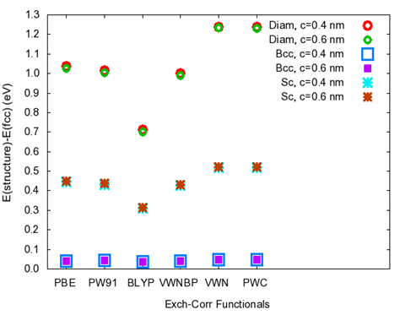
Uncertainties in DFT
k-point convergence
Controlled approximations:
Errors can be made arbitrarily small through adjustable parameters typically at the expense of increased computational cost (Ex: k-points, real space or energy cutoff, basis set)
Cutoff
Exchange-correlation choice
Uncontrolled approximations:
Their errors are unknown exactly and can’t be reduced by increasing the computation (Ex: exchange-correlation, pseudopotential)
Si, DMol3
Notes:
To evaluate uncertainties, we need first to understand WHERE they come from
DFT is QM …. All that we don’t know goes in the Exch-Corr term

Slide 22
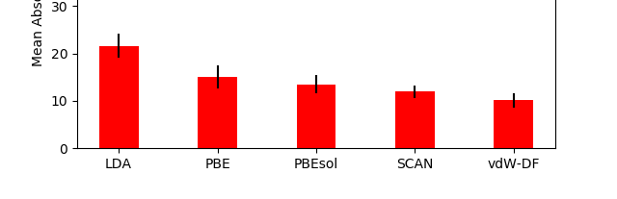
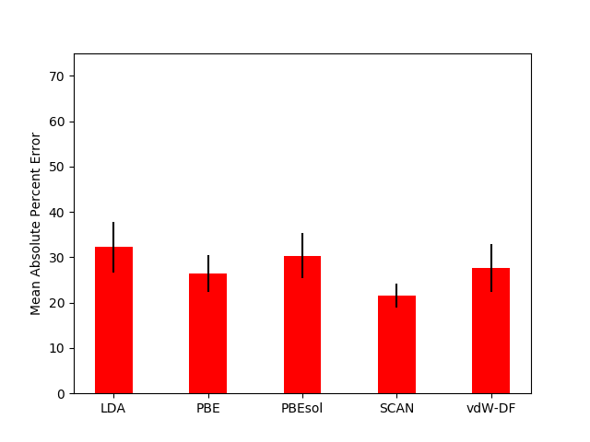
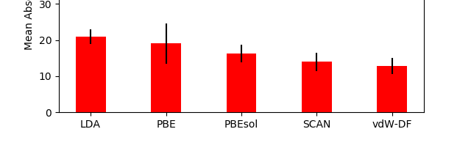
Uncontrolled approximations: exchange-correlation functionals
Accuracy evaluation (i.e. comparison to experimental data)
49 elements, mostly metallic (single elements and compounds)
Focus on elastic properties
Exp. data at T=4K ➔ good match for DFT T=0K calculations
C₁₁
Mean Absolute Percent Error
C₄₄
C₁₂
Mean Absolute Percent Error

Slide 23
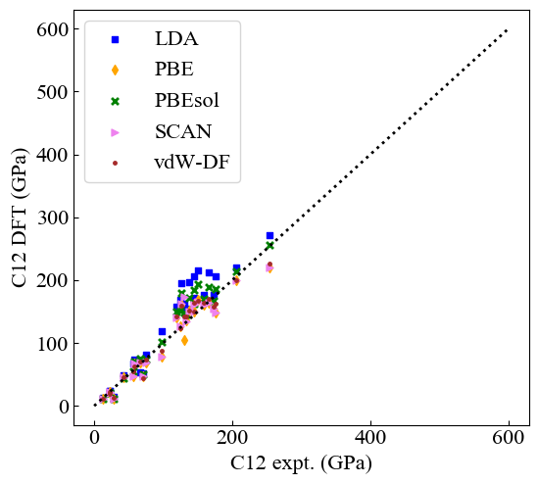
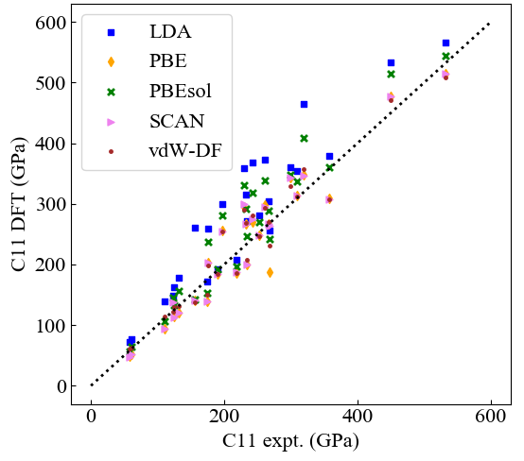
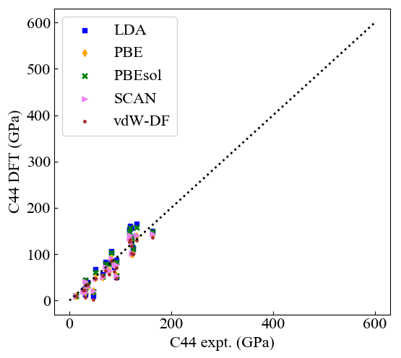

Slide 24
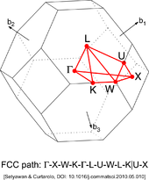
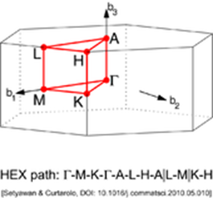
Controlled approximations
Understanding the effect of k-point density on material property evaluation
The DFT estimation of material properties is as approximate an estimate as numerically precise is the integration of the energy functional (depends on k-points density and size of basis set).
- How does kpoint density affect the precision of E₀, B, B’, V₀?
- Do all derived properties attain the same level of numerical precision at the same kpoint density ?
We used a mathematical extrapolation of material properties calculated at various k-points densities to estimate the numerical precision in a derived property for a known level of energy convergence
Notes:
GS energy is calculated as NUMERICAL INTEGRATION over reciprocal space ➔ importance of k-points
In all DFT papers it is specified the energy convergence criteria …. Forces if they are good … No mention of convergence on derived quantities

Slide 25
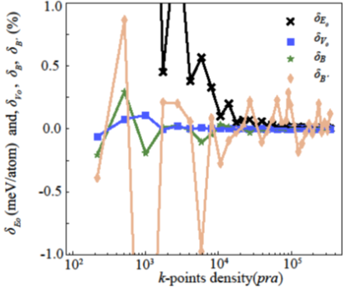




δ_{P}(k) = $\frac{P\left(k\right)−P∞}{P∞} x 100$
P = property = E, V, B, dB/dP
Cr(bcc)
Cr(bcc)
V
dB/dP
Notes:
DeltaP(k) = Numerical precision

Slide 26




Main Findings
numerical precision vs k-point density:
      Power law decay
δ_{P}(k) = c k^{m}
Slope m:
$$\left|m_{\text{d}\text{E}\text{(}\text{k}\text{)}}\right|$$
>
$$\left|m_{\text{d}\text{V}\text{(}\text{k}\text{)}}\right|$$
>
$$\left|m_{\text{d}\text{B}\text{(}\text{k}\text{)}}\right|$$
>
$$\left|m_{\text{d}\text{B}\text{`}\text{(}\text{k}\text{)}}\right|$$
Faster rate of convergence
For a k-point density of 8000 k-points pra, for 90% of metals:
  δ_{Ε}(k) < 0.001 eV/atom a
  δ_{V}(k), δ_{B}(k), and δ_{B`}(k) < 0.1%, 1.0% and 10.0% respectively
Notes:
Slope m: plotting deltaP(k) on a LOG scale

Slide 27



Slide 28



Slide 29


NIST database JARVIS-DFT
Convergence in
k-points and energy cutoff
for E only
Convergence in E: - 1 meV/cell tolerance
- No ionic relaxation
- starting from relaxed MP structures
https://www.ctcms.nist.gov/JARVIS-DFT

Slide 30

All
Materials
#
Only
NON
Metals
#
Only
Metals
#
Kp-Length
Kpoints per atom
Ranges of plane-wave energy cut-off and number of k-points-per-atom.
Metals appear to require more k-points but less cut-off (opposite for non-metals.)

Slide 31


Kp convergence depending on Number of unique elements in the cell
Kp-length needed for 1 meV/cell convergence in E vs Number of unique elements in the cell

Slide 32

Periodic table trend for k-points-requiring material constituents.
The k-points of all the materials were projected on individual elements and their average contribution is shown. A) length-based k-points distribution, b) per atom-based distribution, c) length-based distribution for metals only, d) length-based distribution for non-metals only. The colorbar is in the unit of Å for length-based distributions (a,c,d) and of “per atom” for density distribution (b).

Slide 33
Publications
K. Choudhary, I. Kalish, R. Beams & F. Tavazza, “High-throughput Identification and Characterization of Two-dimensional Materials using Density functional theory,” Scientific Reports 7, 5179 (2017)
K. Choudhary, F.Y. Congo, T. Liang, C.A. Becker, R.G. Hennig, F. Tavazza, “Evaluation and comparison of classical interatomic potentials through a user-friendly interactive web-interface,” Scientific Data 4, 160125 (2017)
K. Choudhary, Q. Zhang, S. Chowdhury, N. Van Nguyen, Z. Trautt, M.W. Newrock, F.Y. Congo, A.C.E. Reid, F. Tavazza, “Computational screening of high-performance optoelectronic materials using OptB88vdW and Tran-Blaha modified Becke-Johnson formalisms in DFT,” accepted for publication in Scientific Data (2018)
K. Choudhary, G. Cheon, E, Reed, F. Tavazza, “Elastic properties of bulk and low-dimensional materials using OptB88vdW functional in density functional theory”, accepted for publication in Phys. Rev. B (2018)
K. Choudhary, B. DeCost, F. Tavazza, “Machine learning with force-field inspired descriptors for materials: fast screening and mapping energy landscape”, accepted for publication in Physical Review Materials (2018)

Slide 34

Conclusions
https://mgi.nist.gov/dft-benchmarking
https://jarvis.nist.gov/

Slide 35
JARVIS-FF
slides

Slide 36



Classical Force Field (FF)
Atomistic modeling
Based on classical mechanics (only treats ions)
Phenomenological expression for energy:
Advantages/Disadvantages
Relatively computationally light:
  large systems (millions of atoms) ➔ extended defects, etc.
  Suitable for MD/MC ➔evolution of systems
  Good predictability of temperature-dependent phenomena
Lots of fitting parameters ➔ not very transferable
Fitting is very time consuming – hard to go beyond ternary systems

Slide 37

JARVIS-FF
Scope:
  to facilitate the user in choosing the right potential for their needs by providing comparison of material properties computed with as many force fields as possible
more than 3000 materials through more than 25000 classical force-field
Force-fields obtained from NIST’s IPR and LAMMPS-potential folder. DFT relaxed structures obtained from Materials-Project
High-throughput LAMMPS calculations
Relaxed structures, Elastic properties, Surface energies, Vacancy formation energies
Properties available for download, code
  available on github:
https://github.com/usnistgov/jarvis

Slide 38


Choosing FF is not easy ….
Wulff construction
MP (mp-134): B_{v}=83 GPa G_{v}=25 GPa
Notes:
The Wulff construction is a method to determine the equilibrium shape of a droplet or crystal of fixed volume inside a separate phase
Nice way of representing the dependence of the interfacial energy on the surface plane orientation.
Bulk Modulus – Shear modulus

Slide 39




… which is why we provide comparisons on as many properties as we can
Convex hull plot for Ni-Al system
Bulk Modulus (DFT vs FF)
a) DFT (MP data), b) Force-field (Mishin Ni-Al potential)
Make your own defect/surface at: https://github.com/usnistgov/jarvis
Notes:
Real materials are VERY defective !
Vacancy structures based on unique Wyckoff positions
Delete symmetrically distinct sites only
Surface created upto three miller indices
Surface energies are generally underestimated

Slide 40
Extra Slides

Slide 41
NIST Databases
Several currently available databases in computational solid state material science (DFT-based).
NIST databases are complimentary to those already out there:
  Quantum (DFT) calculations
  Classical calculations (Force fields)
  Repository of machine learning (ML) parameters
JARVIS-FF
JARVIS-DFT
JARVIS-ML
DFT Benchmarking
HT comparison of Classical FF: Structural, Elastic, Defects, and Phonon Properties
HT identification, characterization of technologically relevant materials (low dimensional, solar cell, etc.)
ML predictions of material properties using chemical and classical force-field inspired descriptors
UQ for DFT calculations: effects of parameters choices (kp, smearing, etc.)

Slide 42


Few basics
Materials Science is all about: Structure-Property-Performance relationship and minimization of free-energy
Computationally: Structure = lattice constants (a,b,c), angles (alpha, beta, gamma) and basis vectors ([Si,0, 0,0],[Si,0.5,0.0,0.5],…..)
To calculate property: classical physics (e.g. classical force-fields), quantum physics (e.g. density functional theory)
MGI motivated current computational databases: Materials-project (MP), AFLOW, OQMD
MIT, LBNL
(67,486 materials)
Duke University
(1,640,245 materials)
Northwestern university
(471,857 materials)
+SQS
Email: kamal.choudhary@nist.gov
Others: AIIDA, MaterialWeb, NREL-MatDB etc.

Slide 43






JARVIS-DFT
JARVIS-FF
JARVIS-ML
Force-field (classical)
Density-functional theory (quantum)
Machine learning (data-driven)
Schrödinger's cat
Solve Newton’s equation for atomic positions
Approximations for V (force-fields):
EAM, EIM, MEAM, AIREBO, REAXFF, COMB, COMB3, TERSOFF, SW etc.
Contains:
thousands of automated LAMMPS based force-field calculations on DFT geometries. Some of the properties included in JARVIS-FF are energetics, elastic constants, surface energies, defect formations energies and phonon frequencies of materials
Time: Takes years to fit FFs
Website: https://www.ctcms.nist.gov/~knc6/periodic.html
Publications:
Choudhary et al., Nature:Scientific Data 4, 160125 (2017)
Choudhary et al., arXiv:1804.01024
Neural nets, decision trees, fuzzy-logic etc.
Solve Scrodinger equation for electrons
>30,000 materials data (3D, 2D, 1D, 0D)
Contains:
Energetics, diffraction pattern, radial distribution function, band-structure, density of states, carrier effective mass, temperature and carrier concentration dependent thermoelectric properties, elastic constants and gamma-point phonons
Time: 5000 cores for last 4 years
Website: https://www.ctcms.nist.gov/~knc6/JVASP.html
Publications:
Choudhary et al., Nature:Scientific Reports 7, 5179 (2017)
Choudhary et al., Nature:Scientific Data 5, 180082 (2018)
arXiv:1804.01033v1
Drawing the line, dimensionality reduction?
Uses gradient boosting decision tree
Contains:
Machine learning prediction tools, trained on JARVIS-DFT data.
Some of the ML-predictions focus on energetics, heat of formation, GGA/METAGGA bandgaps, bulk and shear modulus, exfoliation energy, refractive index, magnetic moment, carrier effective masses
Time: Much easier and faster to train
Website: https://www.ctcms.nist.gov/jarvisml/
Publication:
arXiv:1805.07325

Slide 44

Example: 0D system
Molecule like peaks
Calculate energetics as we add vacuum padding in 1, 2 and 3 directions

Slide 45

Classification problem: metal/non-metal, magnetic/non-magnetic materials
ROC-curve: Excellent classification models

