Slide 1
NIST Workshop on Atomistic Simulations for Industrial Needs June 23-24, 2011
Thanks to Chandler Becker for organizing the conference and for arrangements
Computational solutions to industrially-funded simulations
William A. Goddard III
Charles and Mary Ferkel Professor of
Chemistry, Materials Science, and Applied Physics
Director, Materials and Process Simulation Center (MSC)
California Institute of Technology, Pasadena, California 91125
email: wag@wag.caltech.edu

Slide 2
industrially supported projects
Always Impossible, forces new theory developments
Chevron Corporation: catalysis CH₄ to CH₃OH, ionic liquids for catalysis
Dow Chemical: water swelling in building materials:Dow Solar: CIGS-CdS solar cells
Dow Corning: Catalysts for Production of Silanes for Silicones
Ford Motor Company: Fuel Cells: Cathode catalyst, degradation of Nafion,
AquaNano-Nestle: new polymers selective water treatment at low pressure
Samsung: Alkaline Fuel Cells, cheap DNA sequencing
Sanofi-Aventis: Structures active and inactive ligand-GPCR complexes
Allozyne: non natural AA, Structure GLP-1R and binding to GLP-1
Asahi Glass: Fluorinated Polymers and Ceramics
Asahi Kasei: Ammoxidation Catalysis, polymer properties
Avery-Dennison: Nanocomposites for computer screens Adhesives, Catalysis
Berlex Biopharma: Sanofi-Aventis: Structures and Function of chemokine GPCRs
Boehringer-Ingelheim: Pfizer Corp: Structures and Function of GPCRs
BP: Heterogeneous Catalysis (alkanes to chemicals, EO)
Dow Chemical: Microstructure copolymers, Catalysis polymerize polar olefins
Dupont: degradation of Nafion PEM
Exxon Corporation: Catalysis (Reforming to obtain High cetane diesel fuel)
General Motors - Wear inhibition in Aluminum engines
GM advanced propulsion: Fuel Cells (H2 storage, membranes, cathode)
Hughes Research Labs: Hg Compounds for HgCdTe from MOMBECarbon Based MEMS
Intel Corp: Carbon Nanotube Interconnects, nanoscale patterning
Kellogg: Carbohydrates/sugars (corn flakes) Structures, water content
3M: Surface Tension and structure of polymers
Nippon Steel: CO + H2 to CH3OH over metal catalysts
Nissan: tribology of diamond like carbon (DLC) films
Owens-Corning: Fiberglas (coupling of matrix to fiber)
PharmSelex: Design new pharma for GPCRs
Saudi Aramco: Up-Stream additives (Demulsifiers, Asphaltenes)
Seiko-Epson: Dielectric Breakdown, Transient Enhanced Diffusion Implanted B
Toshiba: nanostructure of CVD SiNxOy for microelectronics using ReaxFF
Now active
Completed successfully
Spin-Offs:
Accelrys (public) – MD software
Schrödinger –QM, bio software
Allozyne – therapeutics new AA
Systine (new) – damage free Etching
AquaNano (new)- water treatment

Slide 3
We develop methods and software simultaneously with Applications to the most challenging materials problems.
FUEL CELL CATALYSTS: Oxygen Reduction Reaction (Pt alloy, nonPGM)
SOLAR ENERGY: dye sensitized solar cells, CuInGaSe (CIGS/CdS)
BATTERIES: Li and F ion systems for primary and secondary applications
GAS STORAGE (H₂, CH₄, CO₂) : MOFs, COFs, metal alloys, nanoclusters
THERMOELECTRICS: (nanowires for high ZT at low T)
CERAMICS: Fuel Cell electrodes and membranes, Ferroelectrics, Superconductors
NANOSYSTEMS: Nanoelectronics, molecular switches, CNT Interconnects
SEMICONDUCTORS: damage free etching for <32 nm, control surface function
POLYMERS: Higher Temperature Fuel Cell PEM, alkaline electrolytes
CATALYSTS ALKANE AMMOXIDATION: MoVNbTeOx: propane➔CH₂=CHCN
CATALYSTS METHANE TO LIQUID: Ir, Os, Rh, Ru organometallic (220C)
ENVIRONMENT and WATER: Captymers for Selective removal ions at low press.
BIOTECHNOLGY: Membrane Proteins, Pharma, Novel Amino Acids
ENERGETIC MATERIALS: PETN, RDX, HMX, TATB, TATP, propellants
MultiParadigm Strategy enables application of 1st principles to synthesis of complex systems

Slide 4
Materials Design Requires Improvements in Methods to Achieve Required Accuracy. Our developments:
1:Quantum Mechanics
Challenge: increased accuracy
New Functionals DFT (dispersion)
Quantum Monte Carlo methods
Tunneling thru molecules (I/V)
2:Force Fields
Challenge: chemical reactions
ReaxFF- Describe Chemical Reaction processes, Phase Transitions, for Mixed Metal, Ceramic, Polymer systems
Electron Force Field (eFF) describe plasma processing
3:Molecular Dynamics
Challenge: Extract properties essential to materials design
Non-Equilibrium Dynamics
  Viscosity, rheology
  Thermal Conductivity
Solvation Forces (continuum Solv)
  surface tension, contact angles
Hybrid QM/MD
Plasticity, Dislocations, Crack
Interfacial Energies
Reaction Kinetics
Entropies, Free energies
4:Biological Predictions
1st principles structures GPCRs
1st principles Ligand Binding
5:MesoScale Dynamics
Coarse Grained FF
Hybrid MD and Meso Dynamics
6: Integration: Computational Materials Design Facility (CMDF)
Seamless across the hierarchies of simulations using Python-based scripts
Enable 1st principles on complex systems

Slide 5
Applications for Industry
Need to get accurate free energies and entropy for simulations of reactive processes and interfaces BEFORE doing the experiment
In silico prototyping
Particular advantage: surfaces and interfaces
Today: emphasize critical issues in obtaining the desired accuracy

Slide 6
Strategy Industrial Projects: Couple 1st Principles to Simulations on realistic materials
Need 1st Principles simulations of macroscale systems so can predict synthesis ofNEW materials never before synthesized prior to experiment
1st Principles→ connect Macro to QM. Strategy use an overlapping hierarchy of methods (paradigms) (fine scale to coarse)
Allows Design of new materials and drugs (predict hard to measure properties )
time
ELECTRONS ATOMS GRAINS GRIDS
simulations real devices and full cell (systems biology)
hours
millisec
nanosec
picosec
femtosec
Continuum
(FEM)
Micromechanical modeling
Protein clusters
MESO
MD
Deformation and Failure
Protein Structure and Function
QM
distance
Big breakthrough making FC simulations practical:
reactive force fields based on QM
Describes: chemistry,charge transfer, etc. For metals, oxides, organics.
Å nm micron mm yards
Accurate calculations for bulk phases and molecules (EOS, bond dissociation)
Chemical Reactions (P-450 oxidation)

Slide 7
Fundamental philosophy for multiscale paradigm
Do QM calculations on small systems ~100 atoms to get accurate energies, geometries, stiffness
Then fit QM to a force field (potential) that can be used to describe much larger systems (10,000 to 1,000,000 atoms)
For even larger systems use calculations with atomistic force field to fit the parameters of a coarse grain force field
For continuum systems fit parameters to results from atomistic and coarse grain force fields
Thus the macroscopic properties are based ultimately on first principles (QM) allowing us to predict novel materials for which no empirical data is available.
If our force fields are derived partly from empirical data, we have no basis for extensions to novel systems.

Slide 8
Starting point for first principles theory and simulation: Quantum Mechanics
Ab initio methods: Hartree-Fock, Generalized Valence Bond, CAS-SCF, MP2, coupled cluster (CC)
At the coupled cluster level accuracy of ~1 kcal/mol=0.05 eV for CBS
But cost scales as N**7. Practical for small systems (benzene dimer)
Density Function Theory: replace the 3N electronic degrees of freedom needed to define the N-electron wavefunction Ψ(1,2,…N) with just the 3 degrees of freedom for the electron density ρ(x,y,z).
Functional not known but now have accurate approximations
LDA = Local Density Theory
PBE = Perdew, Burke, Ernzerhof (1996)
B3LYP = Becke-3 parameters-Lee,Yang,Parr (1995)
M06 = Minnosota 2006 (Don Truhlar)

Slide 9
Accuracy of Methods (Mean absolute deviations MAD, in eV)
For a test set of 223 molecules for which accurate experimental data serves as a benchmark of accuracy
HOF = heat of formation;
IP = ionization potential,
EA = electron affinity,
PA = proton affinity,
BDE = bond dissociation
Generally B3LYP and M06 good for organometallics
B3LYP and PBE bad for vdw interactions
average error in cohesive energy
HF 211 kcal/mol; PBE = 23 kcal/mol
B3LYP = 4.7 kcal/mol, M06-2X=2.9 kcal/mol

Slide 10
DFT is at the heart of our QM applications
Current flavors of DFT accurate for properties of many systems
B3LYP and M06 useful for chemical reaction mechanisms
Example: Reductive elimination of CH₄ from (PONOP)Ir(CH₃)(H)⁺ Goldberg exper at 168K barrier ΔG‡ = 9.3 kcal/mol.
ΔG(173K)
B3LYP
M06
M06L
0.0
0.0
0.0
10.8
5.8
11.4
(reductive elimination)
B3LYP and M06L perform well.
M06 underestimates the barrier.

Slide 11
DFT allows first principles predictions on new ligands, oxidation states, and solvents
Error bars depend on details of calculations (flavor DFT, basis set).
We use best available methods and compare to available experimental data on known systems to assess the accuracy for new systems.
H/D exchange was measured from 153-173K by Girolami (J . Am. Chem. Soc., Vol. 120, 1998 6605) by NMR to have a barrier of ΔG‡ = 8.1 kcal/mol.
ΔG(173K)
B3LYP
M06
0.0
0.0
8.7
9.5
(reductive elimination)
4.6
5.3
(σ-bound complex)
6.4
5.2
(site-exchange)
M06 and B3LYP functionals both consistent with experimental barrier site exchange.

Slide 12
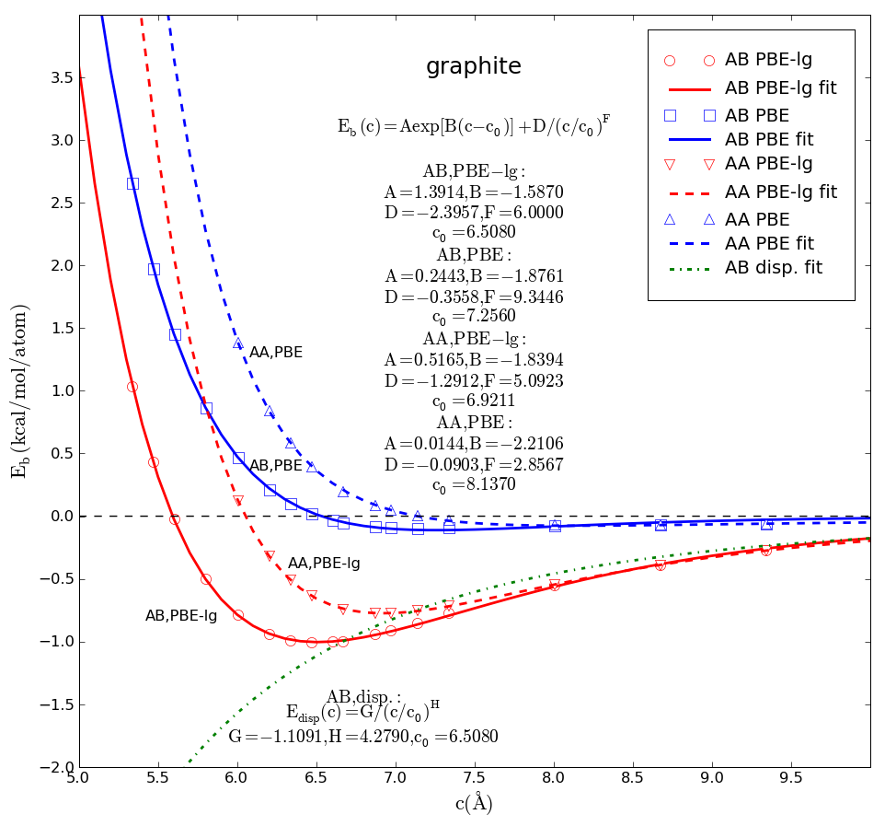
Current challenge in DFT calculation for soft materials
Current implementations of DFT describe well strongly bound geometries and energies, but fail to describe the long range van der Waals (vdW) interactions.
Get volumes ~ 10% too large,
heats of vaporization 85% too small
General Problem with DFT: bad description of vdw attraction
exper
Graphite layers not stable with DFT

Slide 13
DFT bad for Hydrocarbon Crystals
Most popular form of DFT for crystals – PBE (VASP software)
Sublimation energy (kcal/mol/molecule)
PBE 85-90% too small
Molecules | PBE | PBE-ℓg | Exp.
Benzene | 1.051 | 12.808 | 11.295
Naphthalene | 2.723 | 20.755 | 20.095
Anthracene | 4.308 | 28.356 | 27.042
Cell volume (angstrom³/cell)
PBE 12-14% too large
Molecules | PBE | PBE-ℓg | Exp.
Benzene | 511.81 | 452.09 | 461.11
Naphthalene | 380.23 | 344.41 | 338.79
Anthracene | 515.49 | 451.55 | 451.59
Reason DFT formalism not include London Dispersion (-C6/R⁶) responsible for van der Waals attraction

Slide 14
XYG3 approach: include London Dispersion in DFT
Görling-Levy coupling-constant perturbation expansion
Double excitations to virtuals
where
Get {c₁ = 0.8033, c₂ = 0.2107, c₃ = 0.3211} and c4 = (1 – c3) = 0.6789
XYG3 leads to mean absolute deviation (MAD) =1.81 kcal/mol,
B3LYP: MAD = 4.74 kcal/mol.
M06: MAD = 4.17 kcal/mol
M06-2x: MAD = 2.93 kcal/mol
M06-L: MAD = 5.82 kcal/mol .
G3 ab initio (with one empirical parameter): MAD = 1.05
G2 ab initio (with one empirical parameter): MAD = 1.88 kcal/mol
but G2 and G3 involve far higher computational cost.
Problem 5th order scaling with size
Doubly hybrid density functional for accurate descriptions of nonbond interactions, thermochemistry, and thermochemical kinetics; Zhang Y, Xu X, Goddard WA; P. Natl. Acad. Sci. 106 (13) 4963-4968 (2009)

Slide 15
XYGJ-λOS approach to include London Dispersion in DFT include only opposite spin and only local contributions
{ex, eVWN, eLYP, ePT2} ={0.7731,0.2309, 0.2754, 0.4264}.
XYGJ-λOS same accuracy as XYG3 but scales like N³ not N⁵.
XYGJ-LOS
XYGJ-OS
XYGJ-OS
XYGJ-ΛOS
Igor Ying Zhang,
Xin Xu, Yousung Jung, and wag
XYGJ-ΛOS

Slide 16
Accuracy of Methods (Mean absolute deviations MAD, in eV)
Heat Form.
barrier heights
clusters
4 empirical parms
HOF = heat of formation; IP = ionization potential,
EA = electron affinity, PA = proton affinity,
BDE = bond dissociation energy,
NHTBH, HTBH = barrier heights for reactions,
NCIE = the binding in molecular clusters

Slide 17
Comparison of speeds
diamondoid
alkane

Slide 18
Heats of formation (kcal/mol)
small molecules
Large molecules

Slide 19
Truhlar NHTBH38/04 set and HTBH38/04 set
Reaction barrier heights (kcal/mol)

Slide 20
Truhlar NCIE31/05 set
Nonbonded interaction (kcal/mol)

Slide 21
Current challenge in DFT calculation for soft materials
Current implementations of DFT describe well strongly bound geometries and energies, but fail to describe the long range van der Waals (vdW) interactions.
Get volumes ~ 10% too large, heats of vaporiation 85% too smale
XYGJ-λOS solves this problem but much slower than standard methods
DFT-low gradient (DFT-lg) method accurate description of the long-range1/R⁶ attraction of the London dispersion but at same cost as standard DFT
Basic idea
First-Principles-Based Dispersion Augmented Density Functional Theory: From Molecules to Crystals; Yi Liu and wag; J. Phys. Chem. Lett., 2010, 1 (17), pp 2550–2555
Extension of DFT-ℓg for accurate Dispersive Interactions for Full Periodic Table
Hyungjun Kim, Jeong-Mo Choi, wag, to be published
Notes:
The density of crystalline energetic materials is considered to be one of the primary physical parameters in detonation performance, since detonation velocities and pressures of energetic materials are proportional to powers in the density.
We propose here a simple first-principles based augmentation to DFT that
• Describes the 1/R6 London dispersion that is valid at long range where molecular orbitals do not overlap.
• Maintains small forces—low gradients—at short distances that affect valence geometries, which DFT can describe well.
• Introduces only a single set of parameters for each pair-wise interaction type (C-C, C-H, H-H) derived from highly accurate ab initio calculations, which is transferable for correcting interactions of large molecular complexes and crystals.
We adopt the DFT-Low Gradient (DFT-g) model of eq. (1):
Here Cg,ij is the parameter measuring the strength of the missing dispersive interaction between atoms i and j separated by rij. To determine the scale at which this dispersion form is appropriate, we take R0ij as the typical
equilibrium vdW distance between atoms i and j. Here we adopt the vdW radii from the UFF force fields8. The scaling parameter bg = 1 is fixed here, but it is adjustable when shifting the location of the maximum gradient is necessary. The Dg dispersion function becomes constant at short ranges and changes monotonically with distance so that it will not affect valence geometries.
21

Slide 22
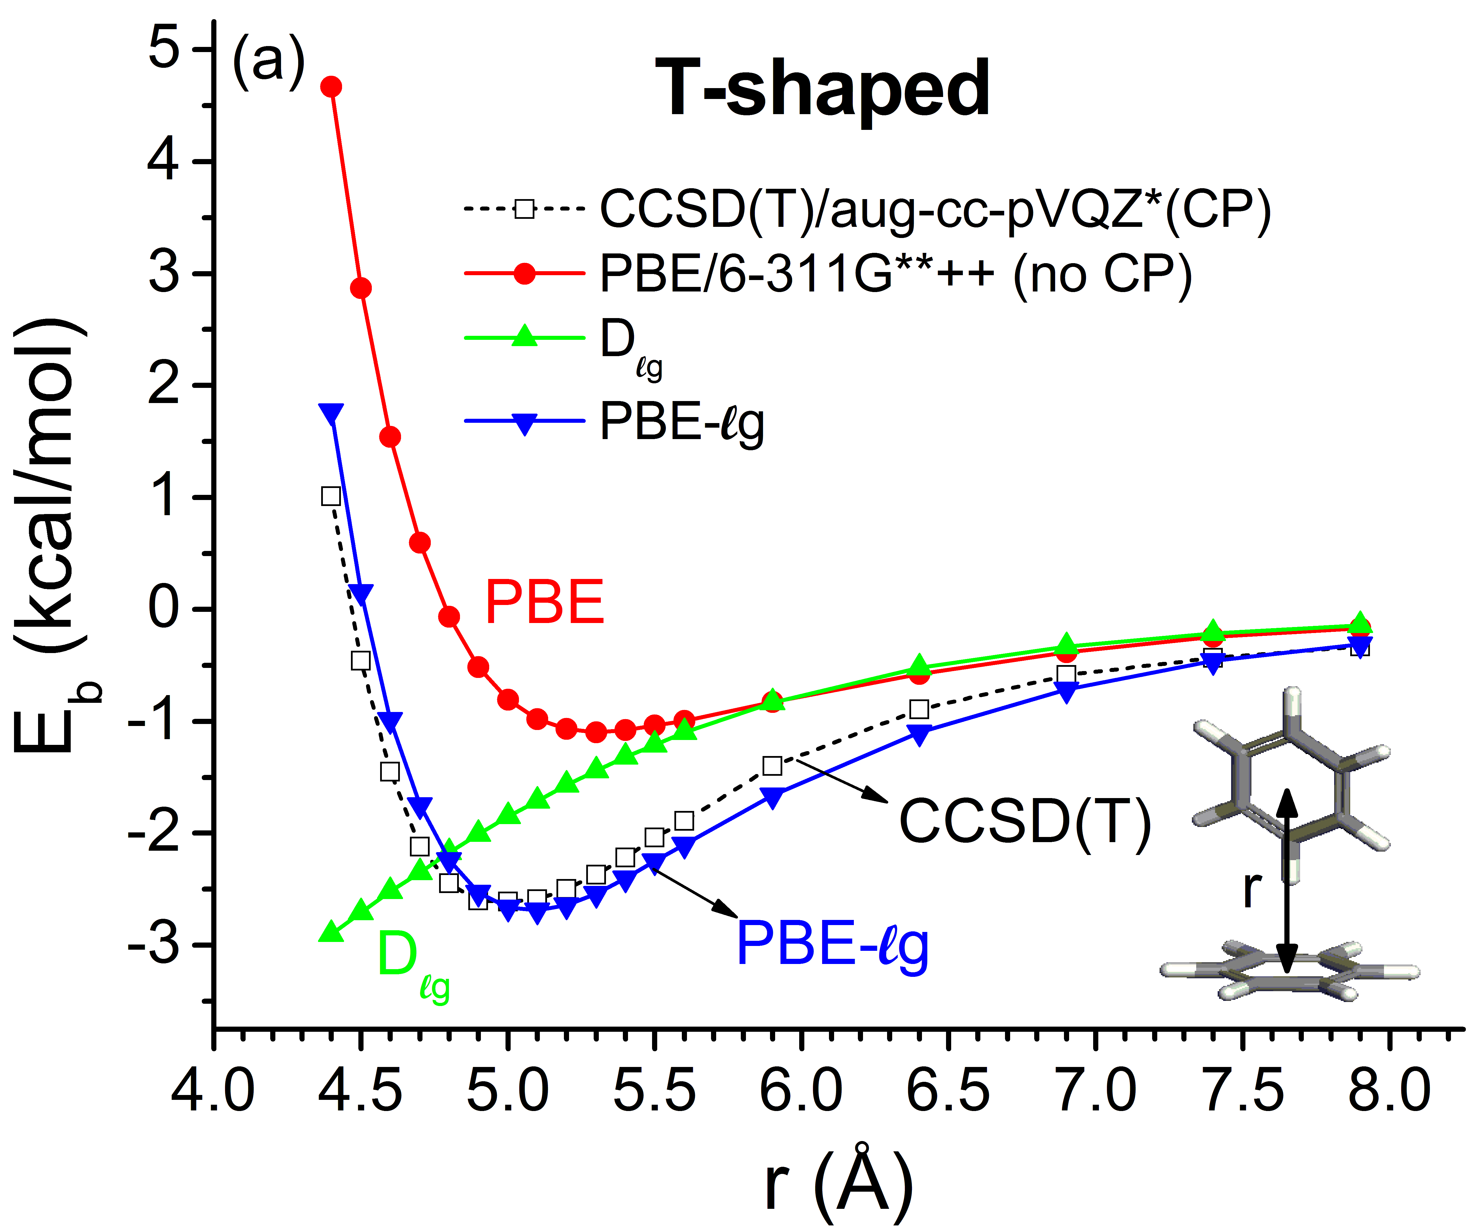
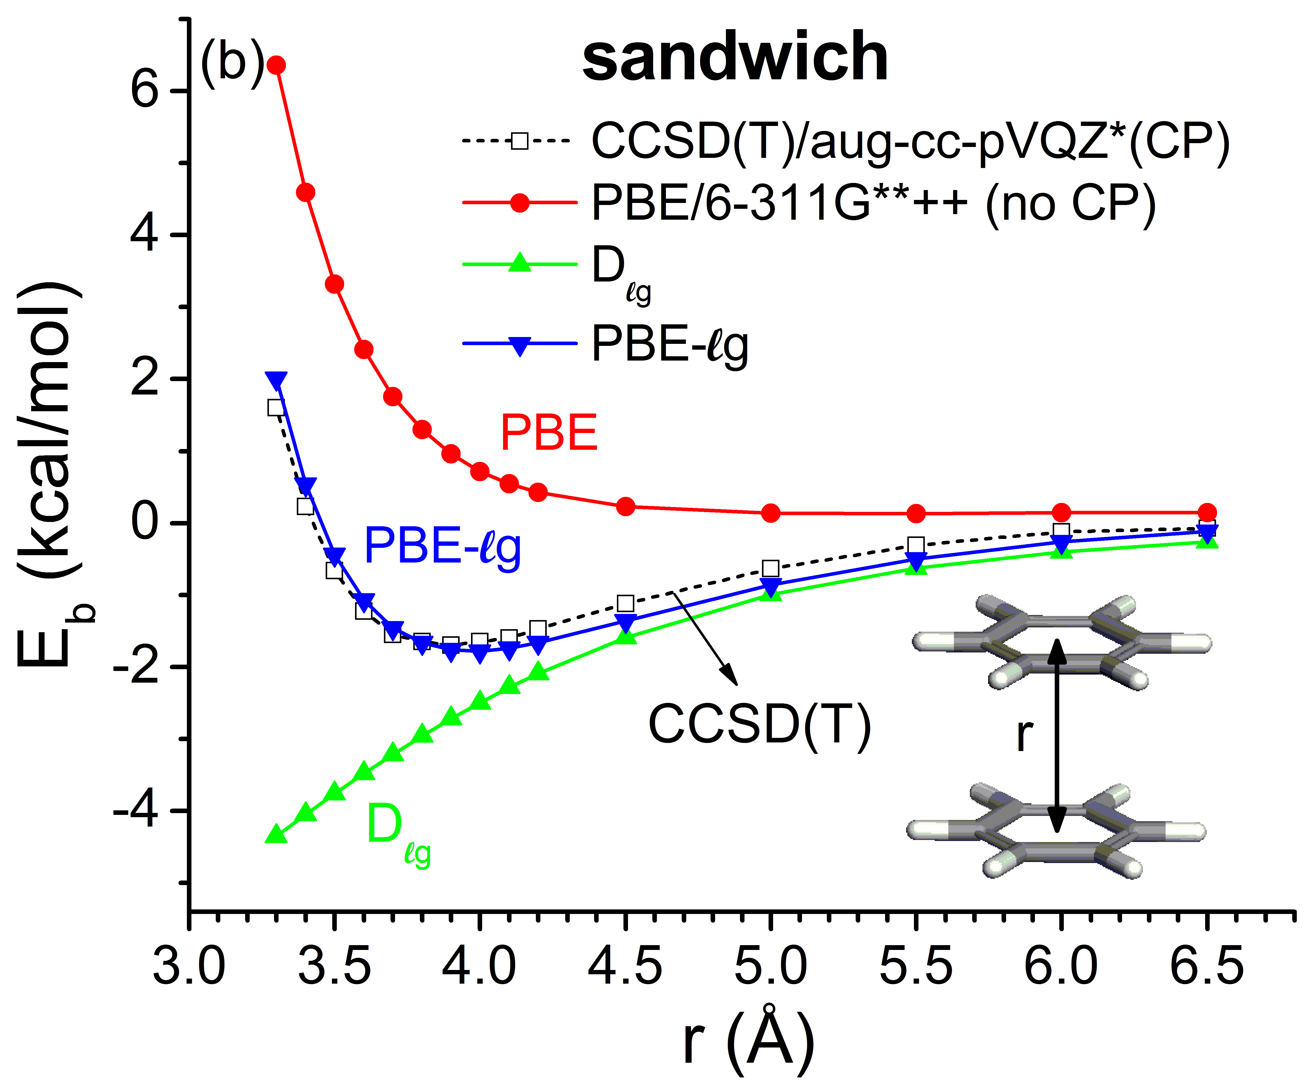
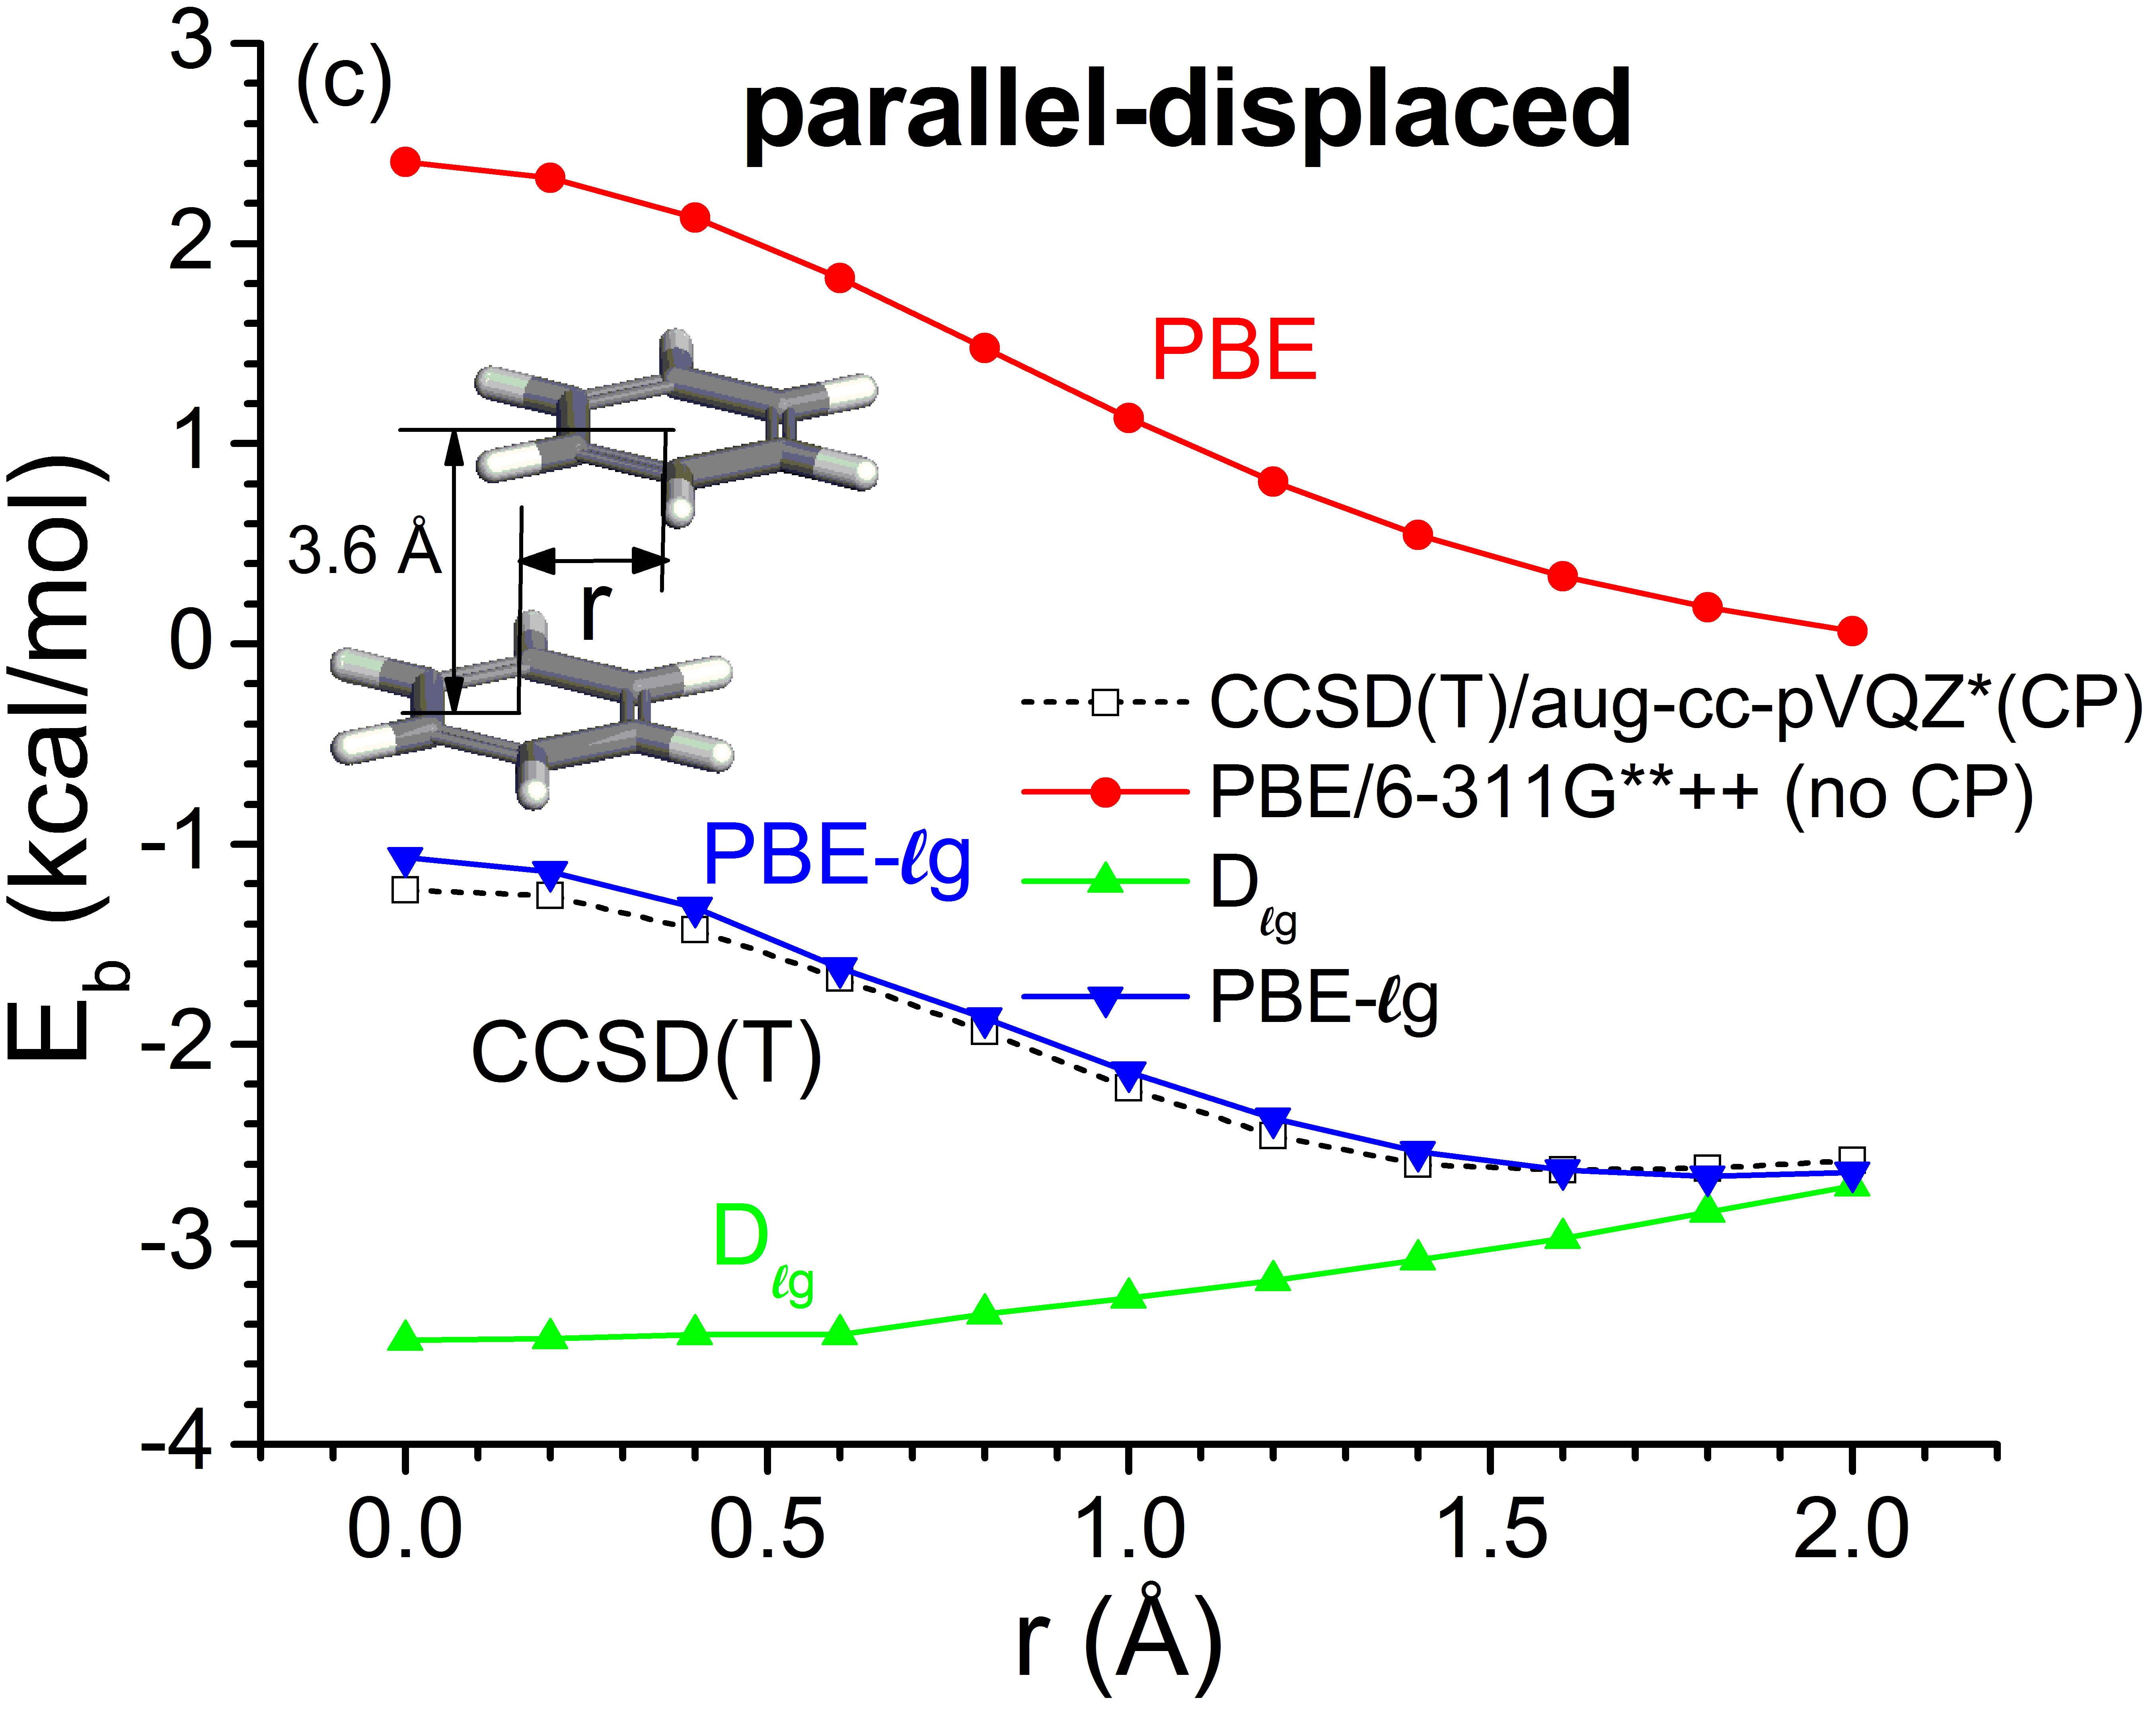
PBE-lg for benzene dimer
T-shaped
Sandwich
Parallel-displaced
PBE-lg parameters
C_{lg}-CC=586.8, C_{lg}-HH=31.14, C_{lg}-HH=8.691
R_{C} = 1.925 (UFF), R_{H} = 1.44 (UFF)
First-Principles-Based Dispersion Augmented Density Functional Theory: From Molecules to Crystals’ Yi Liu and wag; J. Phys. Chem. Lett., 2010, 1 (17), pp 2550–2555
Notes:
22

Slide 23
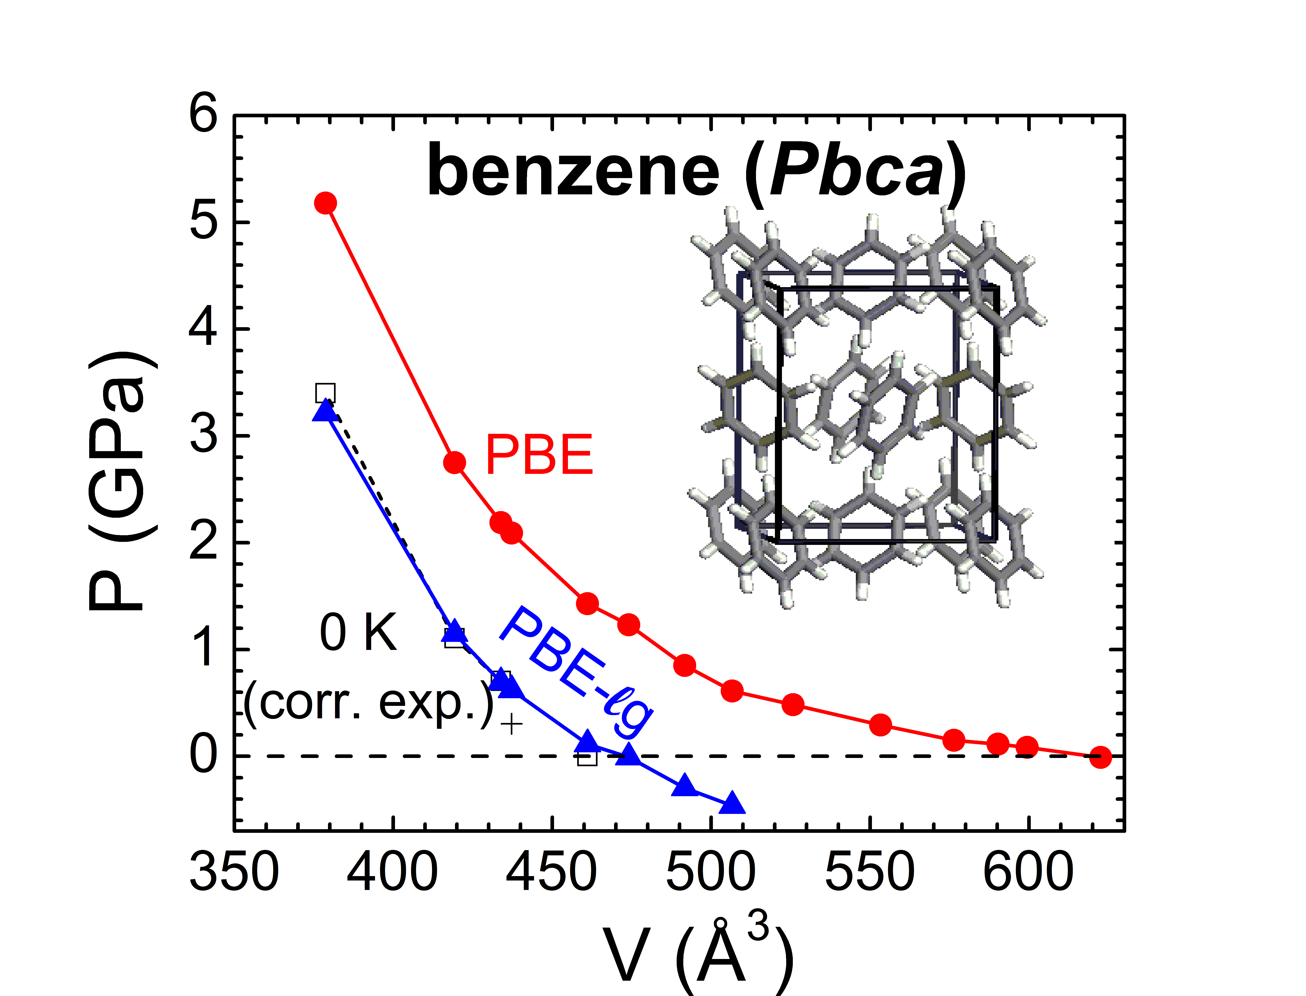
DFT-lg description for benzene
Exper 0K
PBE-lg predicted the EOS of benzene crystal (orthorhombic phase I) in good agreement with corrected experimental EOS at 0 K (dashed line).
Pressure at zero K geometry: PBE: 1.43 Gpa; PBE-lg: 0.11 Gpa
Zero pressure volume change: PBE: 35.0%; PBE-lg: 2.8%
Heat of sublimation at 0 K: Exp:11.295 kcal/mol; PBE: 0.913; PBE-lg: 6.762
Notes:
23

Slide 24
DFT-lg description for graphite
Binding energy (kcal/mol)
PBE➔
PBE-lg ➔
Exper E
0.8, 1.0, 1.2
c lattice constant (A)
Exper c 6.556
graphite has AB stacking (also show AA eclipsed graphite)
Notes:
24

Slide 25
DFT-ℓg for accurate Dispersive Interactions for Full Periodic Table
Hyungjun Kim, Jeong-Mo Choi, William A. Goddard, III
Materials and Process Simulation Center, Caltech
Center for Materials Simulations and Design, KAIST
Notes:
25

Slide 26
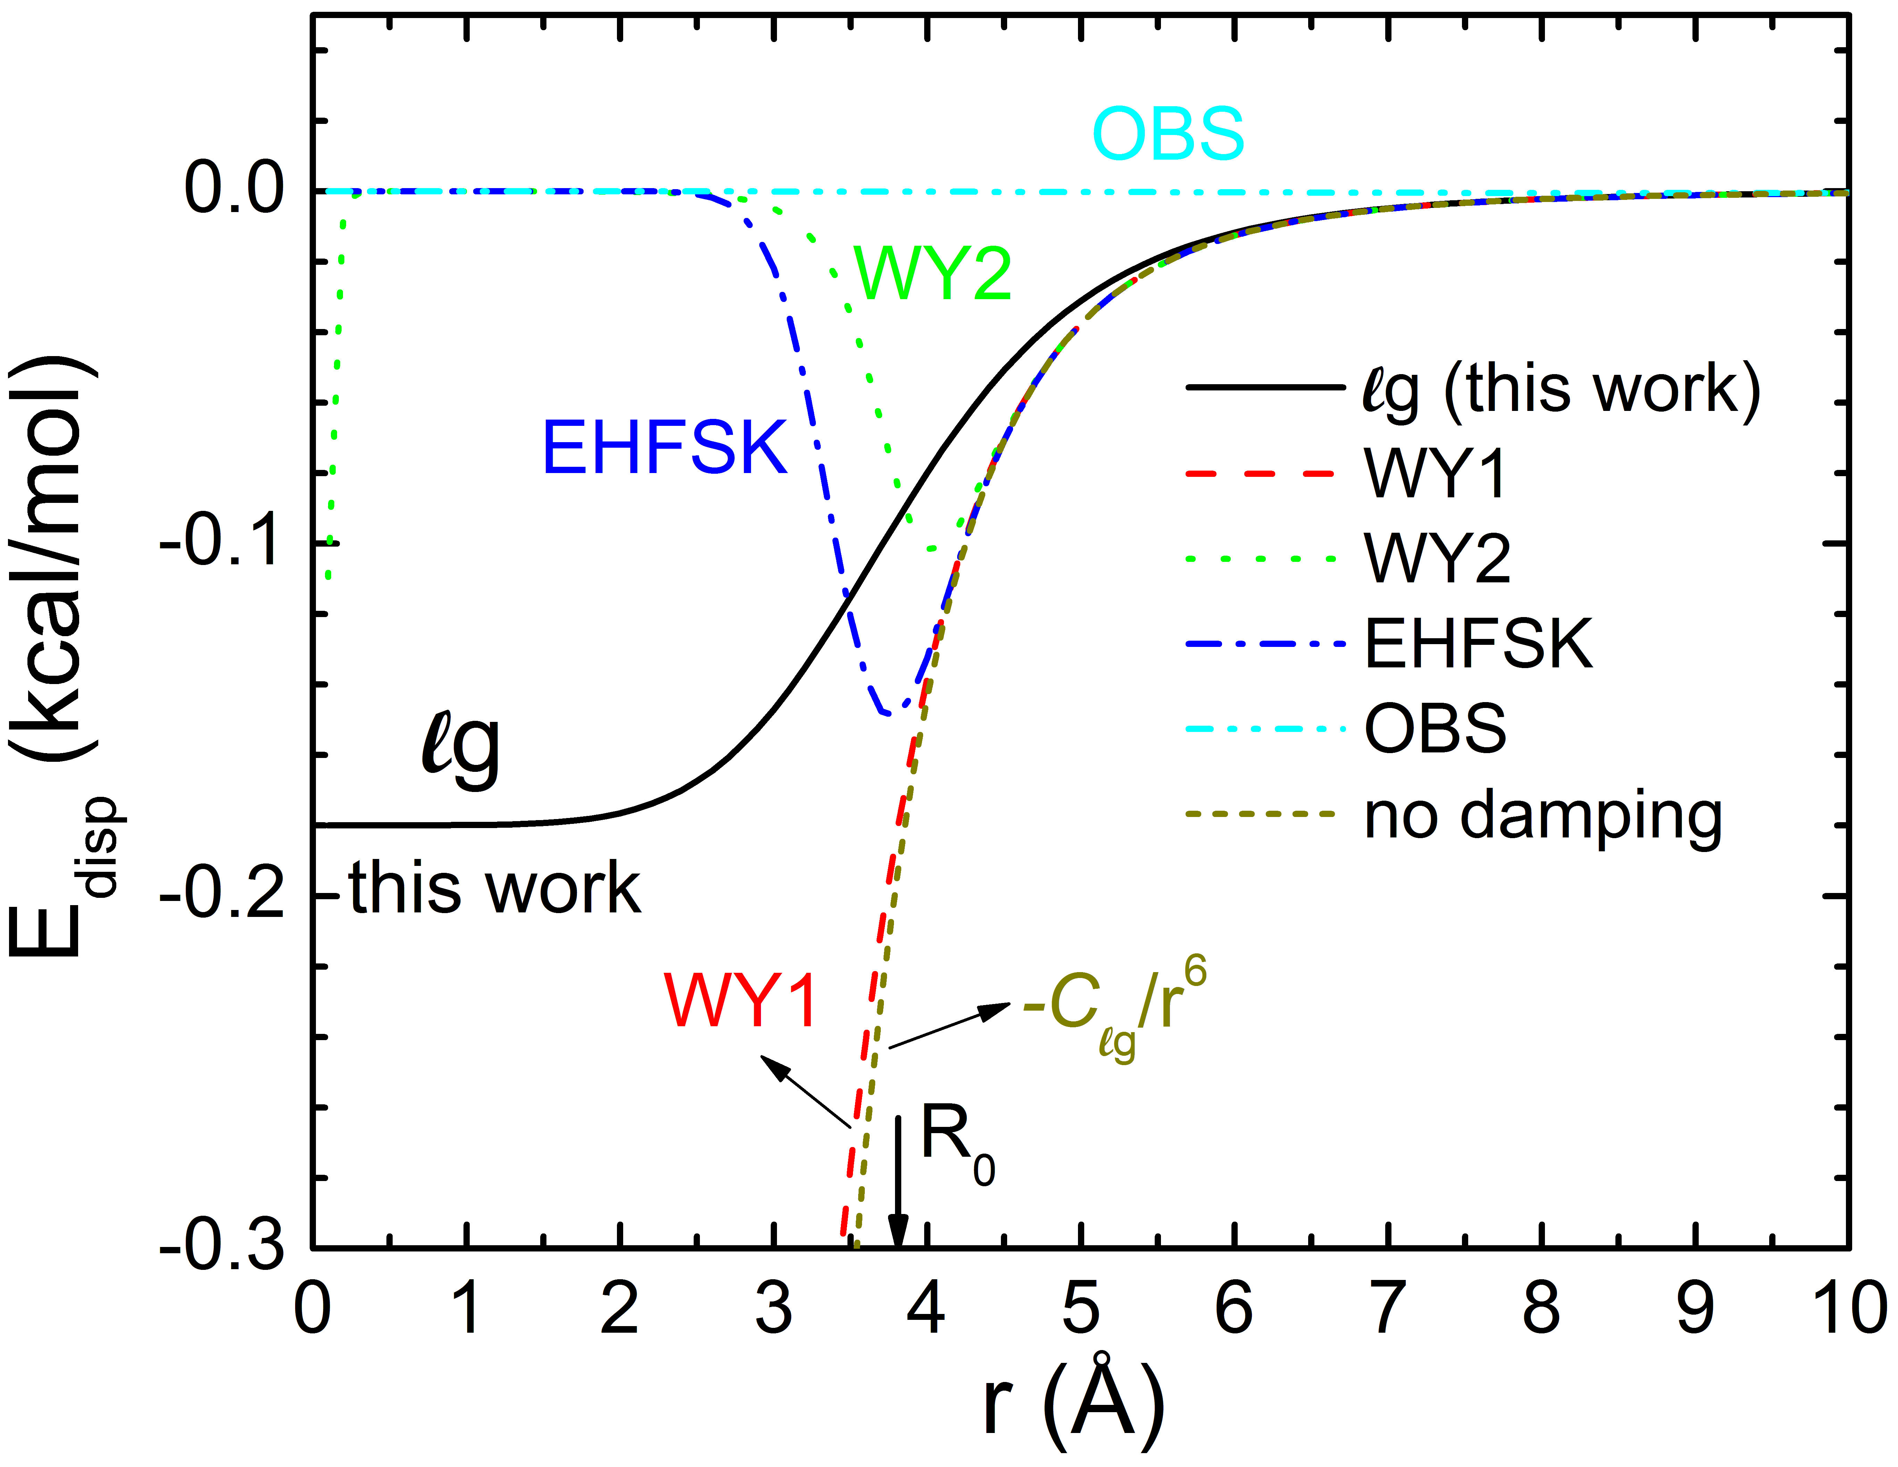
Universal PBE-ℓg Method
UFF, a Full Periodic Table Force Field for Molecular Mechanics and Molecular Dynamics Simulations; A. K. Rappé, C. J. Casewit, K. S. Colwell, W. A. Goddard III, and W. M. Skiff; J. Am. Chem. Soc. 114, 10024 (1992)
Derived C₆/R⁶ parameters from scaled atomic polarizabilities for Z=1-103 (H-Lr) and derived Dvdw from combining atomic IP and C₆
Universal PBE-lg: use same Re, C₆, and De as UFF, add two universal empirical parameters s_{lg} = 0.7012 and b_{lg} = 0.6966
PBE-lg defined for full periodic table up to Lr (Z=103)

Slide 27
PBE-lg using UFF parameters
Implemented in VASP 5.2.11
Parameters for PBE-lg were fitted to Benzene dimer CCSD(T)
Use R_{0i} and D_{0i} from UFF
Get s_{lg} = 0.7012
b_{lg}=0.6966
Use for PBE-lg up to Lr (Z=103)

Slide 28
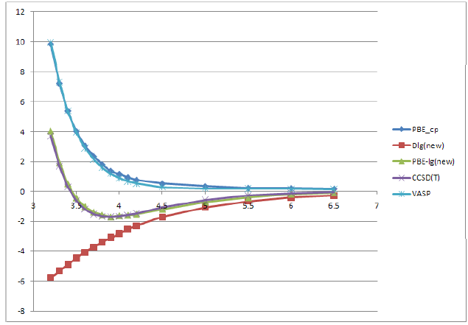
Benzene Dimer - sandwich
PBE
CCSD(T)
PBE-lg

Slide 29
Hydrocarbon Crystals
Most popular form of DFT for crystals – PBE (VASP software)
Sublimation energy (kcal/mol/molecule)
PBE-lg 3 to 15% too high (zero point energy)
Molecules | PBE | PBE-ℓg | Exp.
Benzene | 1.051 | 12.808 | 11.295
Naphthalene | 2.723 | 20.755 | 20.095
Anthracene | 4.308 | 28.356 | 27.042
PBE-lg 0 to 2% too small, thermal expansion
Cell volume (angstrom³/cell)
Molecules | PBE | PBE-ℓg | Exp.
Benzene | 511.81 | 452.09 | 461.11
Naphthalene | 380.23 | 344.41 | 338.79
Anthracene | 515.49 | 451.55 | 451.59
Reason DFT formalism not include London Dispersion (-C6/R⁶) responsible for van der Waals attraction

Slide 30
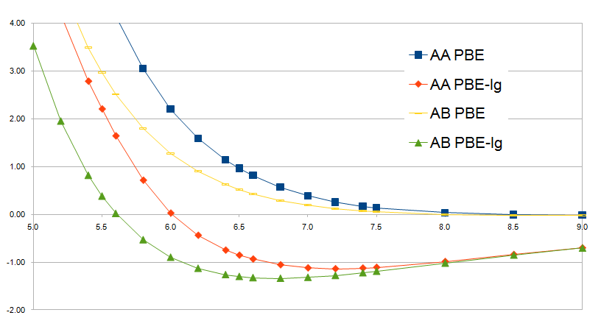
Graphite Energy Curve
BE = 1.34 kcal/mol (QMC: 1.38, Exp: 0.84-1.24)
c =6.8 angstrom (QMC: 6.8527, Exp: 6.6562)

Slide 31
Molecular Crystals PBE-lg, NO parameters
Molecules | PBE | PBE-ℓg | Exp.
F₂ | 0.27 | 1.38 | 2.19
Cl₂ | 2.05 | 5.76 | 7.17
Br₂ | 5.91 | 10.39 | 11.07
I₂ | 8.56 | 14.47 | 15.66
O₂ | 0.13 | 1.50 | 2.07
N₂ | 0.02 | 1.22 | 1.78
CO | 0.11 | 1.54 | 2.08
CO₂ | 1.99 | 4.37 | 6.27
Sublimation energy (kcal/mol)
Molecules | PBE | PBE-ℓg | Exp.
F₂ | 126.47 | 126.32 | 128.24
Cl₂ | 282.48 | 236.23 | 231.06
Br₂ | 317.30 | 270.06 | 260.74
I₂ | 409.03 | 345.13 | 325.03
O₂ | 69.38 | 69.35 | 69.47
N₂ | 180.04 | 179.89 | 179.91
CO | 178.96 | 178.99 | 179.53
CO₂ | 218.17 | 179.93 | 177.88
Cell volume (angstrom³/cell)

Slide 32
Plan for next generation of fully 1st principles based force fields
Use XYGJ-λOS to optimize UFF C₆ parameters for PBE-lg for full range up to Lr (Z=103)
Use PBE-lg to optimize structures of molecular crystals (“0K structure”) and do cold compression Equation of State (EoS) up to ~100 GPa (50% density increase) and out to -5 GPa (10% volume expansion)
First do crystals with little of no hydrogen bonding.
Use this to derive 1st principles vdw attraction.
Use geometric combination rules, but where necessary allow off-diagonal
Then do ice and other hydrogen bonded systems to include radial dependence data for HB interactions
Complement this with XYGJ-λOS and PBE-lg calcuations on hydrogen bonded dimers to extract angular dependence (use Dreiding-like 3 atom HB term)
Validate with MD simulations of EoS at experimental temperatures

Slide 33
Plan for next generation of fully 1st principles based force fields
For valence terms, several strategies
For applications not involving reactions, use rule based FF (Dreiding, UFF) but rederived parameters based on highest quality DFT (not use empirical data to determine parameters since will not have experiments on all possible combinations)
For applications involving reactions, extend and parameterize ReaxFF
Validate with MD simulations of EoS at experimental temperatures

Slide 34
Plan for next generation of fully 1st principles based force fields
For valence terms, several strategies
For applications not involving reactions, use rule based FF (Dreiding, UFF) but rederived parameters based on highest quality DFT (not use empirical data to determine parameters since will not have experiments on all possible combinations)
For applications involving reactions, extend and parameterize ReaxFF
Of course no agency will fund such developments, but as in the past (developing Dreiding, UFF, ReaxFF, eFF) we will do without direct funding, but in the context of carrying out applications

Slide 35
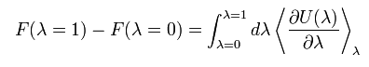
Remaining issue: experimental energies are free energies, need to calculate entropy
General approach to predict Entropy, S, and Free Energy
Free Energy, F = U – TS = − k_{B}T ln Q(N,V,T)
Kirkwood thermodynamic integration
J. G. Kirkwood. Statistical mechanics of fluid mixtures, J. Chem. Phys., 3:300-313,1935
However enormous computational cost required for complete sampling of the thermally relevant configurations of the system often makes this impractical for realistic systems.
Additional complexities, choice of the appropriate approximation formalism or somewhat ad-hoc parameterization of the “reaction coordinate”

Slide 36
Theoretical Methods of calculating ΔG^{solv}
Typical Thermodynamic Cycle
Test Particle Methods (insertion or deletion)
  Good for low density systems
  Perturbation Methods
  Thermodynamic integration, Thermodynamic perturbation
  Applicable to most problems
  Require long simulations to maintain “reversibility”
Nonequilibrium Methods (Jarzinski’s equality)
  Obtaining differential equilibrium properties from irreversible processes
  Require multiple samplings to ensure good statistics
Solute (water)
Dummy atoms (water)
ΔG_{solv}
-ΔG^{dummy}
Solute
(vacuum)
Dummy (vacuum)
References: Frenkel, D.; Smit, B. Understanding Molecular Simulation from Algorithms to Applications. Academic press: Ed., New York, 2002.
McQuarrie, A. A. Statistical Mechanics. Harper & Row: Ed., New York, 1976.
Jarzynski, C. Nonequilibrium Equality for Free Energy Differences. Phys. Rev. Lett. 1997, 78, 2690.

Slide 37

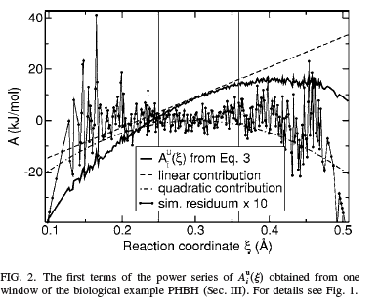
The reaction is divided into windows with a specific value ξ i assigned to each window.
with an additional term correcting for incomplete momentum sampling, the metric-tensor correction
Review: Kastner & Thiel, J. Chem. Phys. 123, 144104 (2005)

Slide 38
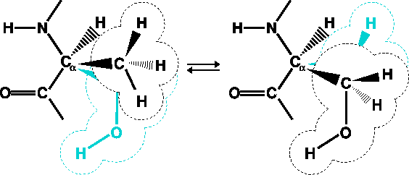
Free Energy Perturbation Theory
Free Energy, F = U – TS = − k_{B}T ln Q(N,V,T)
Kirkwood thermodynamic integration
J. G. Kirkwood. Statistical mechanics of fluid mixtures, J. Chem. Phys., 3:300-313,1935
TI requires enormous computational cost to sample the thermally relevant configurations of the system
This makes TI impractical for realistic systems.
Ad-hoc parameterization of the “reaction coordinate”

Slide 39
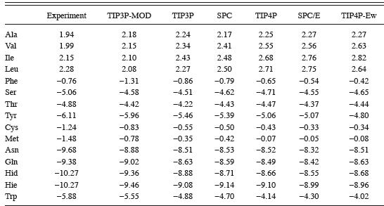
Solvation free energies amino acid side chains
Pande and Shirts (JCP 122 134508 (2005) Thermodynamic integration leads to accurate differential free energies

Slide 40
Solvation free energies amino acid side chains
Pande and Shirts (JCP 122 134508 (2005) Thermodynamic integration leads to accurate differential free energies
But costs 8.4 CPU-years on 2.8 GHz processor

Slide 41
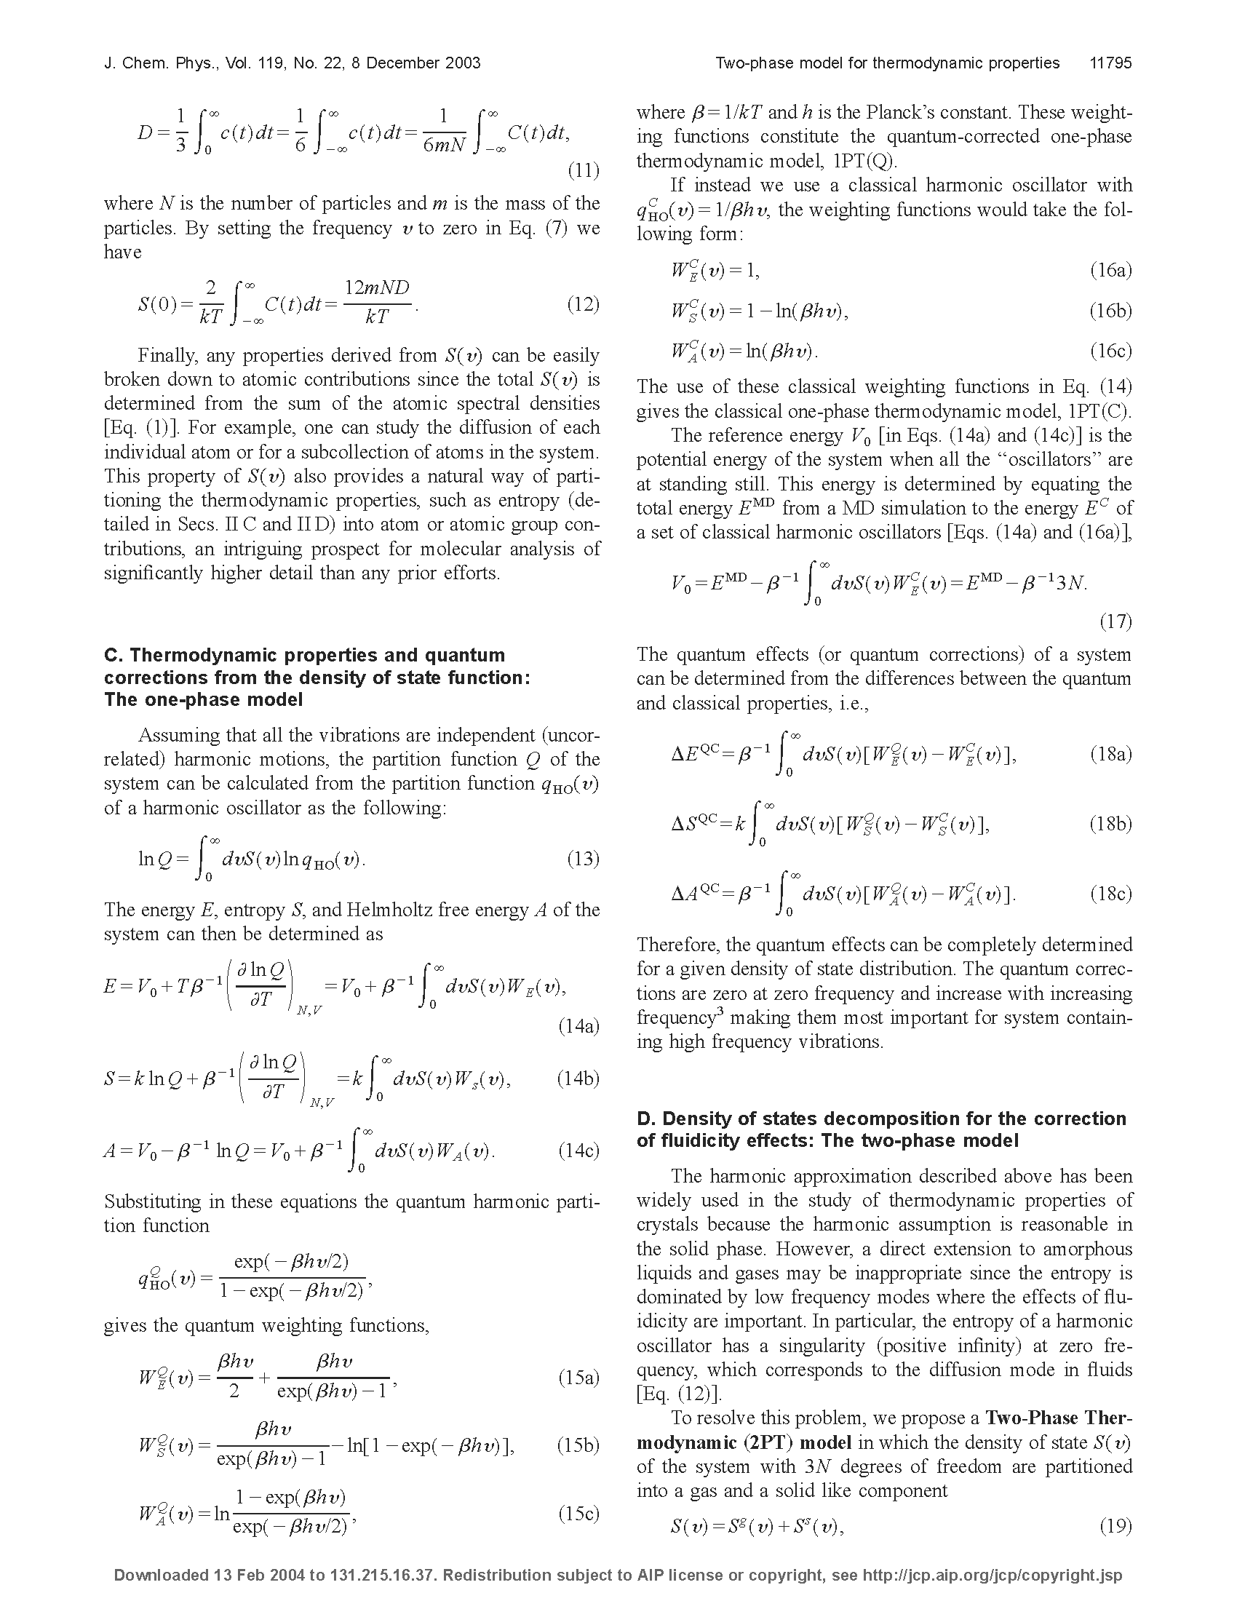
Alternative: get Free Energies from phonon density of states, DoS
Debye crystal
DoS(v) ➔ ν² as ν ➔0
DoS(ν)
ν
The two-phase model for calculating thermodynamic properties of liquids from molecular dynamics: Validation for the phase diagram of Lennard-Jones fluids; Lin, Blanco, Goddard; JCP, 119:11792(2003)

Slide 42

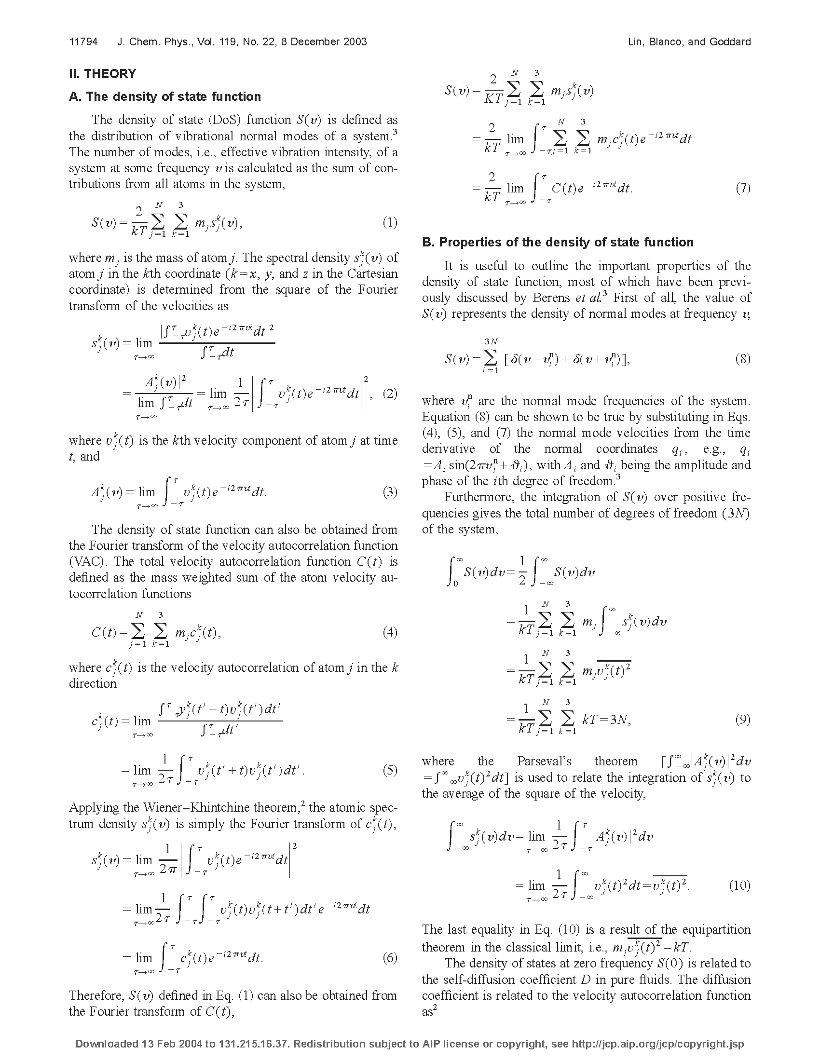
Get Density of states from the Velocity autocorrelation function
Velocity autocorrelation function
DoS(ν) is the vibrational density of States
DoS(ν)
Calculate entropy from DoS(ν)
zero
zero
zero
Problem: as ν ➔ 0 get S ➔ ∞ unless DoS(0) = 0

Slide 43
Problem: for liquids get DoS(0)≠0 at ν = 0
ρ(ω)
total
diffusional
vibration
ρ(ω)
Total power spectrum (Fourier transform of velocity autocorrelation function
log ω (cm⁻¹)
2PT decomposition for H2O

Slide 44
Problem with Liquids: S(0)≠0
Finite density of states at ν =0
Proportional to diffusion coefficient
DoS(ν)
where D is the diffusion coefficient
N=number of particles
M = mass
ν
Also strong anharmonicity at low frequencies
The two-phase model for calculating thermodynamic properties of liquids from molecular dynamics: Validation for the phase diagram of Lennard-Jones fluids; Lin, Blanco, Goddard; JCP, 119:11792(2003)

Slide 45
Two-Phase Thermodynamics (2PT) Model Entropy, Free energy from MD Lin, Blanco, Goddard; JCP, 119:11792(2003)
Velocity autocorrelation function
Vibrational density states
DoS(ν)
MD ➔DoS(ν) ➔ diffusion-like (gas) and solid-like contributions
DoS(ν) _{total} = DoS(ν) _{gas} + DoS(ν) _{solid}
DoS_{gas} fit 2 parameters of hard sphere model to DoS from MD
Gas component describes diffusion part of free energy, entropy
Solid component contains quantum and anharmonic effects
Total
Gas
Solid
solid-like
gas-like
exponential
decay
Debye crystal
S(v) ~v²
=
+
Property =

Slide 46
for liquids get DoS(0)≠0 at ν = 0
ρ(ω)
total
diffusional
vibration
ρ(ω)
Total power spectrum (Fourier transform of velocity autocorrelation function
log ω (cm⁻¹)
2PT decomposition for H2O

Slide 47
Diffusional gas-like phase
Describe the diffusional gas-like component as a hard sphere fluid.
The velocity autocorrelation function of a hard sphere gas decays exponentially
where a is the Enskog friction constant related to the collisions between hard spheres.
Ng = f N is the number of effective hard sphere particles in the system
f = fractional hard sphere component in overall system. Measures “fluidicity” of the system (depends on both temperature and density).
From MD, fit small ν to Hard Sphere model ➔ S(0) and f

Slide 48

Validation of 2PT Using Lennard-Jones Fluids
The two-phase model for calculating thermodynamic properties of liquids from molecular dynamics: Validation for the phase diagram of Lennard-Jones fluids; Lin, Blanco, Goddard; JCP, 119:11792(2003)
stable
metastable
unstable
Supercritical Fluid
Gas
Liquid
Solid
entropy
free energy

Slide 49
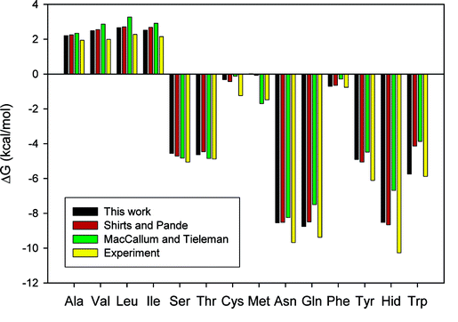
calculated free energies solvation of amino acid side chains
Compare to Pande
2PT has 98% correlation with results of Shirts and Pande
2PT has 88% correlation with experiments – measures accuracy of forcefield
But Total Simulation time: 36.8 CPU hours instead of 8.4 CPU years: Factor of 2000 improvement

Slide 50
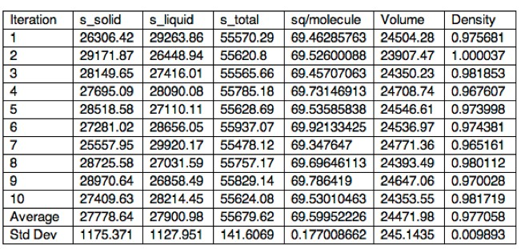
Absolute Entropy of water
Theory: 69.6 +/- 0.2 J/K*mol
Experimental Entropy: 69.9 J/K*mol (NIST)
Statistics collected over 20ps of MD , no additional cost

Slide 51
Get absolute Entropies of liquids
Accuracy in predicted entropy only limited by accuracy of force field
  Thermodynamics of liquids: standard molar entropies and heat capacities of common solvents from 2PT molecular dynamics; Pascal, Lin, Goddard, PhysChemChemPhys,13: 169-181 (2011)

Slide 52
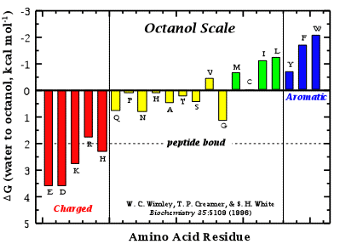
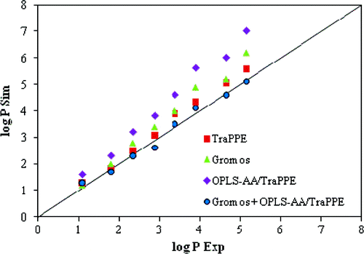

Amino acid Octanol/water partition from 2PT
Experimental data

Slide 53
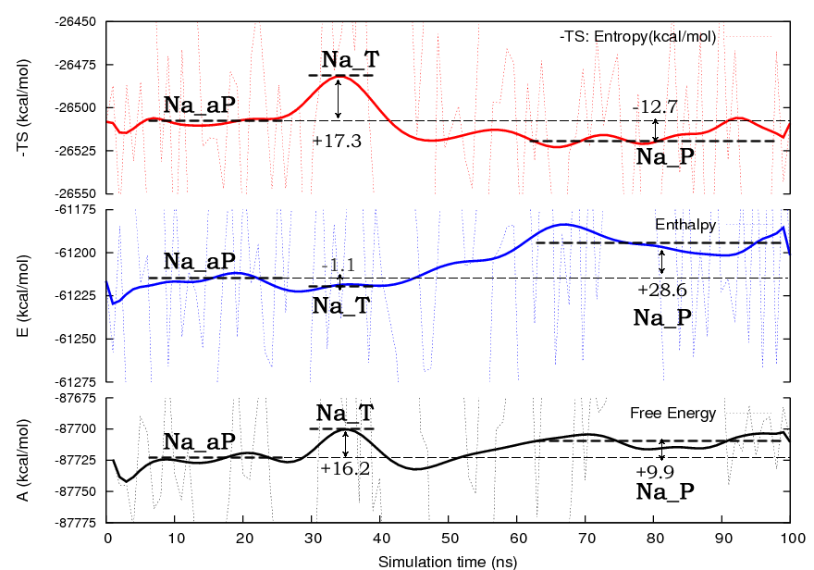
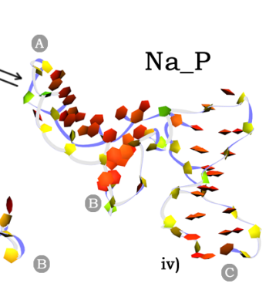


2PT ➔entropy and free energy along the pathway from reactants to products
-TS entropy
enthalpy
Thermodynamics of RNA Three way junction at 285K
Free energy
~50,000 atoms

Slide 54
Summary
The 2PT method predicts accurate solvation free energies from atomic velocities of short MD (20ps)
98% correlation to Thermodynamic Integration but, 2000 times faster
Can treat charged amino-acids by first neutralizing and correcting for pKa corrections
Solvation in various liquids depends only on accuracy of force field
90% correlation with experimental water/octanol partition coefficients using OPLS FF

Slide 55
Plan for Next Generation 1st principles based FF, Validate energetics by comparing to experimental Free Energies
Remaining issue: solvation
Much of the important experimental energy information for validation has the molecules in a liquid
We must include solvation in our QM simulations

Slide 56
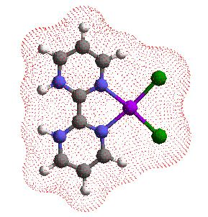
Need accurate predictions of Solvation effects in QM
The Poisson-Boltzmann Continuum Model in Jaguar/Schrödinger is extremely accurate
Calculate Solvent Accessible Surface of the solute by rolling a sphere of radius R_{solv} over the surface formed by the vdW radii of the atoms.
Calculate electrostatic field of the solute based on electron density from the orbitals
Calculate the polarization in the solvent due to the electrostatic field of the solute (need dielectric constant ε)
This leads to Reaction Field that acts back on solute atoms, which in turn changes the orbitals. Iterated until self-consistent.
Calculate solvent forces on solute atoms
Use these forces to determine optimum geometry of solute in solution.
Can treat solvent stabilized zwitterions
Difficult to describe weakly bound solvent molecules interacting with solute (low frequency, many local minima)
Short cut: Optimize structure in the gas phase and do single point solvation calculation. Some calculations done this way
Solvent: ε = 99
R_{solv}= 2.205 A
Implementation in Jaguar (Schrodinger Inc):
pK organics to ~0.2 units, solvation to ~1 kcal/mol
(pH from -20 to +20)

Slide 57
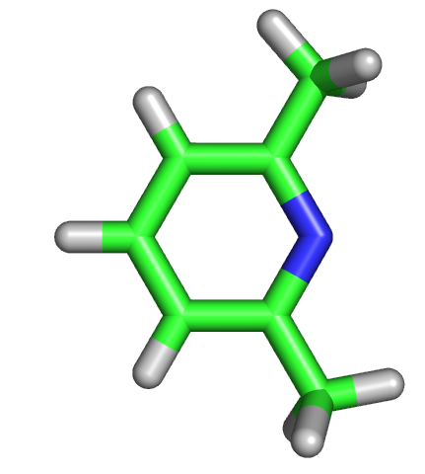
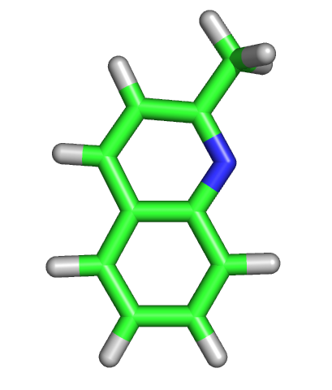
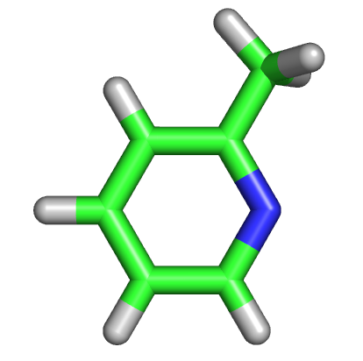
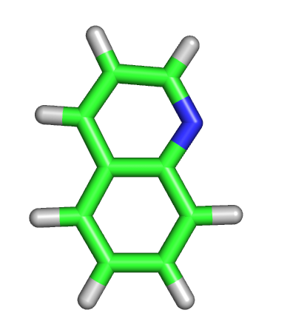
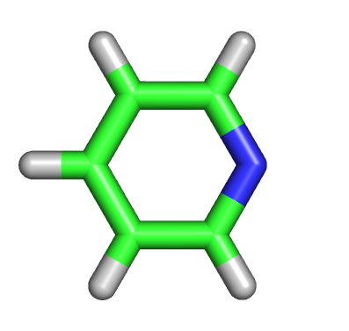
Comparison of Jaguar pK with experiment
pKa: Jaguar (experiment)
E_sol: zero (H+)
6.9 (6.7) -3.89 (-52.35)
5.8 (5.8) -4.96 (-49.64)
6.1 (6.0) -3.98 (-55.11)
5.0 (4.9) -4.80 (-51.84)
5.3 (5.3) -3.90 (-57.94)

Slide 58
Jaguar predictions of Metal-aquo pKa’s
Protonated Complex
(diethylenetriamine)Pt(OH₂)²⁺
PtCl₃(OH₂)¹⁻
Pt(NH₃)₂(OH₂)₂²⁺
Pt(NH₃)₂(OH)(OH₂)¹⁺
cis-(bpy)₂Os(OH)(H₂O)¹⁺
Experimental pK_{a}
6.3
7.1
5.5
7.4
11.0
Calculated (B3LYP) pK_{a}(MAD: 1.1)
5.5
4.1
5.2
6.5
11.3
Calculated (M06//B3LYP) pK_{a} (MAD: 1.6)
9.1
8.8
6.2
10.9
13.0
15.2
11.0
13.9
5.6
6.3
10.9
cis-(bpy)₂Os(H₂O)₂ ²⁺
cis-(bpy)₂Os(OH)(H₂O)¹⁺
trans-(bpy)₂Os(H₂O)₂ ²⁺
trans-(bpy)₂Os(OH)(H₂O)¹⁺
cis-(bpy)₂Ru(H₂O)₂²⁺
cis-(bpy)₂Ru(OH)(H₂O)¹⁺
trans-(bpy)₂Ru(H₂O)₂ ²⁺
trans-(bpy)₂Ru(OH)(H₂O)¹⁺
(tpy)Os(H₂O)₃²⁺
(tpy)Os(OH)(H₂O)₂¹⁺
(tpy)Os(OH)₂(H₂O)
Experimental pK_{a}
7.9
11.0
8.2
10.2
8.9
>11.0
9.2
>11.5
6.0
8.0
11.0

Slide 59
Use theory to predict optimal pH for each catalyst
Predict the relative free energies of possible catalyst resting states and transition states as a function of pH.
Insertion
transition states
34.6
40.0
34.6
32.6
Resting states
37.9
L_{n}Os^{II}(OH₂)₃⁺²
is stable
L_{n}Os^{II}(OH₂)(OH)₂ is stable
L_{n}Os^{II}(OH)₃⁻
is stable
Optimum pH is 8

Slide 60
Predicted Pourbaix Diagram for Trans-(bpy)₂Ru(OH)₂
Black experimental data from Meyer,
Red is from QM calculation (no fitting) using M06 functional, no explicit solvent
Maximum errors:
  200 meV, 2pH units
Experiment: Dobson and Meyer, Inorg. Chem. Vol. 27, No.19, 1988.

Slide 61
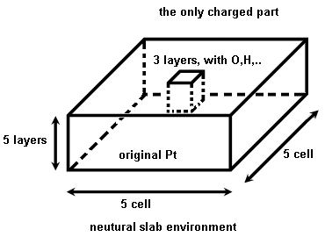
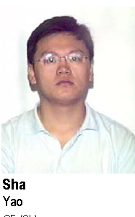
Include Solvent Effect for fuel cell catalysts
Methods:
  Explicit: Hard to implement for periodic slabs.
  Poisson-Boltzmann continuum model
APBS numerical CMDF
  Poisson Boltzmann
  UFF radii
  SeqQuest calculated charge
  c(10x10) surface
61

Slide 62
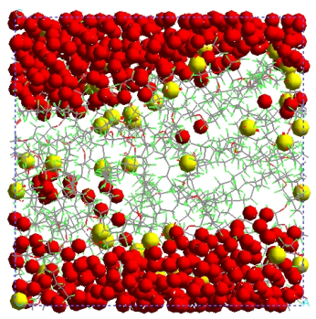

Determine Atomistic Structure of Nafion Membrane
Grow and equilibrate system using the Monti Carlo annealing
Water content | ~5 wt % (3 H₂O/-COOH) | ~10 wt % (7 H₂O/-COOH) | ~10 wt % (7 H₂O/-SO₃H)
Total no. of atom | 5312 | 6080 | 6144
No. of chain | 4 | 4 | 4
No. of carboxylic groups | 64 | 64 | 64
No. of water molecules | 192 | 448 | 448
Temperature | 353.15 K | 353.15 K | 353.15 K
Annealing procedure
2. Temp anneal as gradually increase density to 1.1 density
600 K,30ps
1. MC Grow at 0.5 density
Data collection
353.15 K→ 600 K, 30ps
Volume→200 %
600 K→ 353.15 K, 30ps
Volume → 100 %
5 times
353.15 K,100ps
NVT MD
353.15 K,5 ns
NPT MD
353.15 K, 5 ns
NPT MD
3. Then decrease density gradually to 0.5
4. repeat 5 times

Slide 63
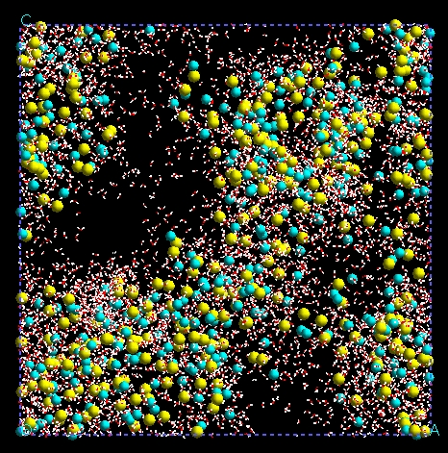
PEM fuel cell use Nafion electrolyte
Determine atomistic structure of Nafion using Monte Carlo plus pressure and temperature annealing
Jang, Molinero, Cagin, Goddard, and J. Phys. Chem. B, 108: 3149 (2004) and Solid State Ionics 175 (1-4 SI): 805 (2004)
Neutral Nafion
systems 1S:15W
(20 wt % water)
The red mesh is water interface.
Each ball is a S of a sulfonate.
Color indicate the molecule to which belong
(4 polymer molecules per cell)
Hydrophobic polymer interface
Hydrophilic polymer interface
80 Å
get large hydrophilic channel which percolates and retains bulk-water structure.
For both monomer sequences, the distribution of sulfonic groups in the interface is uneven: there seem to be hydrophobic and hydrophilic patches.

Slide 64
Model of cathode catalyst membrane interface
Hydrophobic polymer O₂ channel
Nafion PEM
Hydrophilic water channel
O₂
H⁺
catalyst
Carbon support (conductor)
Assume O₂ comes through hydrophobic channel and dissociates on the catalyst surface (if H₂O does not block the site). Model reactions as gas phase
Protons come through hydrophilic channel. Model as forming chemisorbed H on catalyst surface. Model reactions using solvation in water

Slide 65
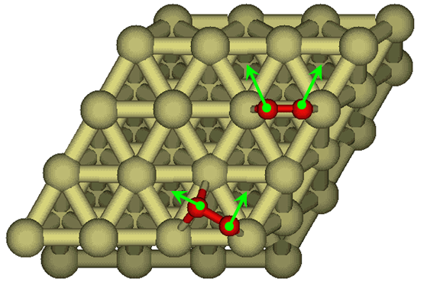
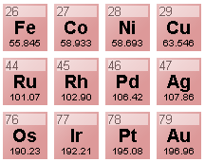
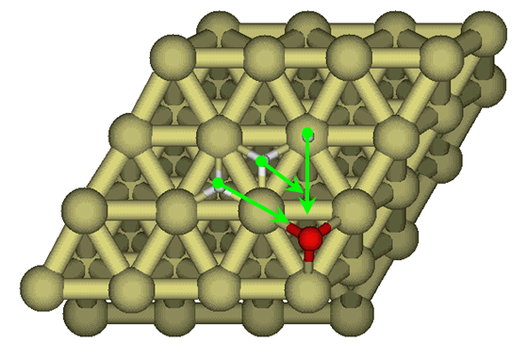
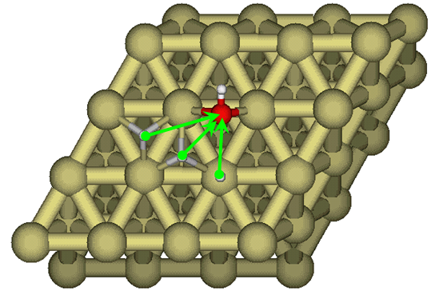
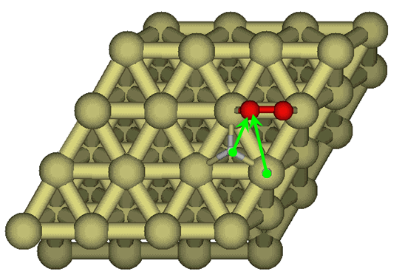
Used QM to determine the binding site and Reaction Barriers (Nudged Elastic Band) for all steps in oxygen reduction reaction (ORR) for 12 metals
  O₂ dissociation
Five steps with a barrier
  O₂ dissociation
  OH formation
  H₂O formation
  OOH formation
  OOH dissociation
Other steps, no barrier
  H₂ dissociation
  H₂O dissociation
  OH formation
  OOH formation
65
  OOH dissociation
  H₂O formation

Slide 66
O₂ activation
Assume: O₂ gets to electrode surface through hydrophobic (Teflon) channel. Dissociates on surface to form O_{ad}
Usual assumption: dissociative mechanism
O_{2g} ➔ O_{2ad} ➔ O_{ad} + O_{ad} E_{act} = 0.57 eV Pt (0.72 eV Pd)
This seems a little too high for rapid catalysis at 80 C

Slide 67
O₂ activation
Assume: O₂ gets to electrode surface through hydrophobic (teflon) channel. Dissociates on surface to form O_{ad}
Usual assumption: dissociative mechanism
O_{2g} ➔ O_{2ad} ➔ O_{ad} + O_{ad} E_{act} = 0.57 eV Pt (0.72 eV Pd
New mechanism [Jacob and wag ChemPhysPhysChem, 7: 992 (2006)]: Associative mechanism
H_{ad} + O_{2ad}➔ HOO_{ad} Eact = 0.30 eV Pt (0.55 eV Pd)
HOOad ➔ Oad + OHad Eact = 0.12 eV Pt (0.26 eV Pd)
Clearly associative mechanism is more favorable, but it requires some H⁺ from hydrophilic phase (water channel) to chemisorb on Pt to form H_{ad}.
What is the cost of getting this H_{ad}?

Slide 68
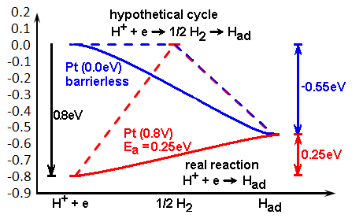
Formation of H_{ad}: Hydrogen reduction
H⁺ + e⁻ ➔ ½ H₂ ΔH = 0 at SHE (standard hydrogen electrode)
H₂ ➔H_{ad} +H_{ad} ΔH = -0.55 eV Pt with no barrier (-0.69 Pd)
Now consider operation at standard H₂ Fuel Cell conditions with a potential of 0.8 eV
Form H_{ad}: net barrier of 0.25 eV Pt (0.11 eV Pd) at 0.8 V potential
Barrier for Had to move along Pt surface is 0.04 eV.
Thus H⁺ from water channel can deliver H_{ad} needed to dissociate O₂ in hydrophobic region

Slide 69
Need to add Had to Oad in hydrophobic region
Barrier for O_{ad} migration on Pt is 0.42 eV (gas phase)
Thus we assume that the H⁺ from the water channel must form H_{ad} (barrier of 0.25 eV at a potential of 0.8 eV) that migrates (0.04 eV barrier) to the O_{ad} and then forms OH_{ad}
O_{ad} + H_{ad} ➔ OH_{ad} Eact = 0.74 eV Pt (0.30 eV Pd)
This is a major problem because for Pt this becomes the RDS
O₂ _{gas} ➔ O_{2ad}
Had + O₂ad➔ HOOad
HOOad ➔ Oad + OHad
Had + Oad ➔ HOad
Had + OHad ➔ H2O
Pt
Pd
Eact = 0.30 eV
0.55 eV
0.26 eV
0.30 eV
0.58 eV
Eact = 0.12 eV
Eact = 0.74 eV
Eact = 0.14 eV
If this were the mechanism then for Pd ORR (Eact= 0.58 eV) would be faster than Pt (Eact = 0.74)
Clearly this cannot be the mechanism

Slide 70
Summary Barriers on pure metals: Rate Determining Step
ORR1
0.74
0.74
ORR2
For Pt, Pd and most metals RDS is Had + Oad ➔ OHad (gas phase)
H_{2gas} ➔ 2 Had
O₂ _{gas} ➔ O_{2ad}
Had + O₂ad➔ HOOad
HOOad ➔ Oad + OHad
Had + Oad ➔ HOad
Had + OHad ➔ H2O
Eact = 0.30 eV
Eact = 0.12 eV
Eact = 0.74 eV
Eact = 0.14 eV
Thus we must Search for new mechanism
70

Slide 71
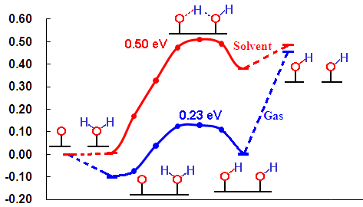
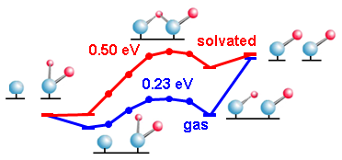
New mechanism: ORR3: O_{ad} hydration
Consider the reaction of O_{ad} with H₂O_{ad}
Gas phase
Energy (eV)
O_{ad} hydration: O_{ad} + H₂O_{ad} ➔ OH_{ad} + OH_{ad} Eact = 0.23 eV Pt
Eact = 0.24 eV Pd
Usual Alternative: O_{ad} + H_{ad} ➔ OH_{ad} Eact = 0.74 eV Pt
Eact = 0.30 eV Pd

Slide 72
New mechanism: ORR3: Oad hydration
H
H
H
H
Pt: E_{act} = 0.23
O
O
➔
O
O
Pt
0
0.30 eV
0.12 eV
0.23 eV
0
0.14 eV
Pd
0
0.55 eV
0.26 eV
0.24 eV
0
0.58 eV
ORR3
O₂ _{gas} ➔ O_{2ad}
Had + O₂ad➔ HOOad
HOOad ➔ Oad + OHad
Oad + H₂Oad ➔ OHad + OHad
H_{2gas} ➔ 2 Had
Had + OHad ➔ H₂Oad
H₂Oad ➔ H₂Ogas
Oad hydration is best way to form OHad
Now Pt the RDS becomes O2 dissociation (Gas Phase)
Pt (0.30 eV) << Pd (0.58 eV) but seems too fast for Pt
Now consider the hydrophilic phase in more detail

Slide 73
Include Solvent Effect for fuel cell catalysts
Methods:
  Explicit: Hard to implement for periodic slabs.
  Poisson-Boltzmann continuum model
APBS numerical CMDF
  Poisson Boltzmann
  UFF radii
  SeqQuest calculated charge
  c(10x10) surface
73

Slide 74
Effect of solvation on barriers
With solvent
Gas phase
Pt
0.00
0.22
0.00
0.50
0.97
0.24
Pd
0.27
0.74
0.10
0.49
0.47
0.78
Pt
0.57
0.30
0.12
0.23
0.74
0.14
Pd
0.72
0.55
0.26
0.24
0.30
0.58
O₂ _{gas} ➔ 2 O_{ad}
Had + O₂ad➔ HOOad
HOOad ➔ Oad + OHad
Oad + H₂Oad ➔ 2 OHad
Had + Oad ➔ HOad
Had + OHad ➔ H2Oad
RDS
RDS
RDS
RDS
RDS
0.50
0.78
0.30
0.58
RDS
Highest solvation effect is for Oad
Big decrease barrier for O₂ _{gas} ➔ 2 O_{ad} by ~0.5 eV
Increases barrier for Oad + H₂Oad ➔ 2 OHad by 0.25 eV
But still more favorable than Had + Oad ➔ HOad
Increases barrier for Had + OHad ➔ H₂Oad by 0.1 to 0.2 eV

Slide 75
Model of catalyst processes
O₂
Hydrophilic water channel
Hydrophobic polymer O₂ channel
H⁺
H₂O
O
H₂O
HO + H
HO
catalyst
Assume O₂ comes through hydrophobic channel and dissociates on the catalyst surface, barrier is large, O stays in hydrophobic
H₂O migrates from water phase and reacts ➔two OH
OH can migrate, so can Had. Get together to make H₂O in water phase.
Critical to PEM FC performance, boundaries between hydrophobic and hydrophilic phases, both must percolate and both must be accessible to reactions at the surface.

Slide 76
Problem: materials synthesis simulations require accurate reaction rates on >10⁵ atoms (10 nm cube) for 100’s of nanoseconds at T = 100-900C
QM can not handle such large systems
Also has problems at high Temperature

Slide 77
Problem: materials synthesis simulations require accurate reaction rates on >10⁵ atoms (10 nm cube) for 100’s of nanoseconds at T = 100-900C
QM not handle such large systems has problems at high Temperature
To solve this problem we developed: ReaxFF reactive force field
Describes reaction mechanisms (transition states and barriers) at ~ accuracy of QM at computation costs ~ ordinary force field MD
short distance Pauli Repulsion + long range dispersion
(pairwise Morse function)
Valence energy
Electrostatic energy
years
MACRO
bonds break, form smoothly
Accurate description reaction barriers.
charges change smoothly as reactions proceed
All parameters from quantum mechanics
ReaxFF describes reactive processes
for 1000s to millions of atoms
MESO
Time
MD
ReaxFF
10⁻¹⁵
QC
Ångstrom
Kilometres
Distance

Slide 78
ReaxFF uses generic rules for all parameters and functional forms
ReaxFF automatically handles coordination changes and oxidation states associated with reactions, thus no discontinuities in energy or forces.
User does not pre-define reactive sites or reaction pathways (ReaxFF figures it out as the reaction proceeds)
Each element leads to only 1 atom type in the force field. (same O in O₃, SiO₂, H₂CO, HbO₂, BaTiO₃) (we do not pre-designate the CO bond in H₂CO as double and the CO bond in H₃COH as single or in CO as triple, ReaxFF figures this out)
ReaxFF determines equilibrium bond lengths, angles, and charges solely from the chemical environment.
Require that One FF reproduces all the ab-initio data (ReaxFF)
Most theorists (including me) thought that this would be impossible, hence it would never have been funded by NSF, DOE, or NIH since it was far too risky. (DARPA came through, then ONR, then ARO).

Slide 79
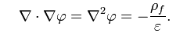
Adri van Duin will describe some of the recent breakthroughs in ReaxFF tomorrow
Today I would like to talk about charges and polarization
For applications of FF to predicting docking of ligands to proteins and for interactions of molecular systems it is now standard to use charges from QM
Of course QM leads to much more than just charges, it provides the full 3D distribution of charges, which by solving the Poisson Equation
gives the full electrostatic potential, φ, generated by the density of free charges, ρ_{f}
But for MD we want to represent this potential with point charges on the atoms
The led to Electrostatically derived charges, the most common approach to extracting QM charges.

Slide 80
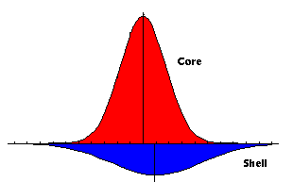
An alternative General but Fast approach to predicting charges is QEq
Self-consistent Charge Equilibration (QEq)
Describe charges as distributed (Gaussian)
Thus charges on adjacent atoms shielded
(interactions ➔ constant as R ➔ 0) and include interactions over ALL atoms, even if bonded (no exclusions)
Allow charge transfer (QEq method)
I
interactions
atomic
2
Keeping:
J_{ij}
Hardness (IP-EA)
Electronegativity (IP+EA)/2
1/r_{ij}
r_{ij}
r_{i}⁰ + r_{j}⁰
Three universal parameters for each element:
1991: use experimental IP, EA, R_{i};

Slide 81
New approach to QEq
Fit χ⁰_{i}, J⁰_{i}, R_{i} for a large data set of molecules
Use a Genetic Algorithm approach to optimize parameters
Validate by testing against predictions of ligand binding energies to known co-crystals
We found that QM charges work well
We want the new QEq to work just as well

Slide 82
New approach to QEq
Fit χ⁰_{i}, J⁰_{i}, R_{i} for a large data set of molecules
Use a Genetic Algorithm approach to optimize parameters
Validate by testing against predictions of ligand binding energies to known co-crystals
We found that QM charges work well
We want the new QEq to work just as well
For some systems, a single charge per atom is too restrictive
For example Ferroelectrics
This led to Polarizable QEq, PQeq

Slide 83
Polarizable QEq
Proper description of Electrostatics is critical
Allow each atom to have two charges:
A fixed core charge (+4 for Ti) with a Gaussian shape
A variable shell charge with a Gaussian shape but subject to displacement and charge transfer
Electrostatic interactions between all charges, including the core and shell on same atom, includes Shielding as charges overlap
Allow Shell to move with respect to core, to describe atomic polarizability
Self-consistent charge equilibration (QEq)
Four universal parameters for each element:
Get from QM

Slide 84
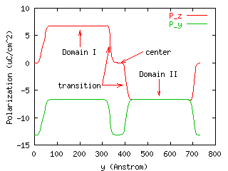
90° Domain Wall of BaTiO₃
z
L
o
y
L=724 Å (N=128)
Wall energy is 0.68 erg/cm²
Stable only for L≥362 Å (N≥64)
Wall center
Transition Layer
Domain Structure
84

Slide 85
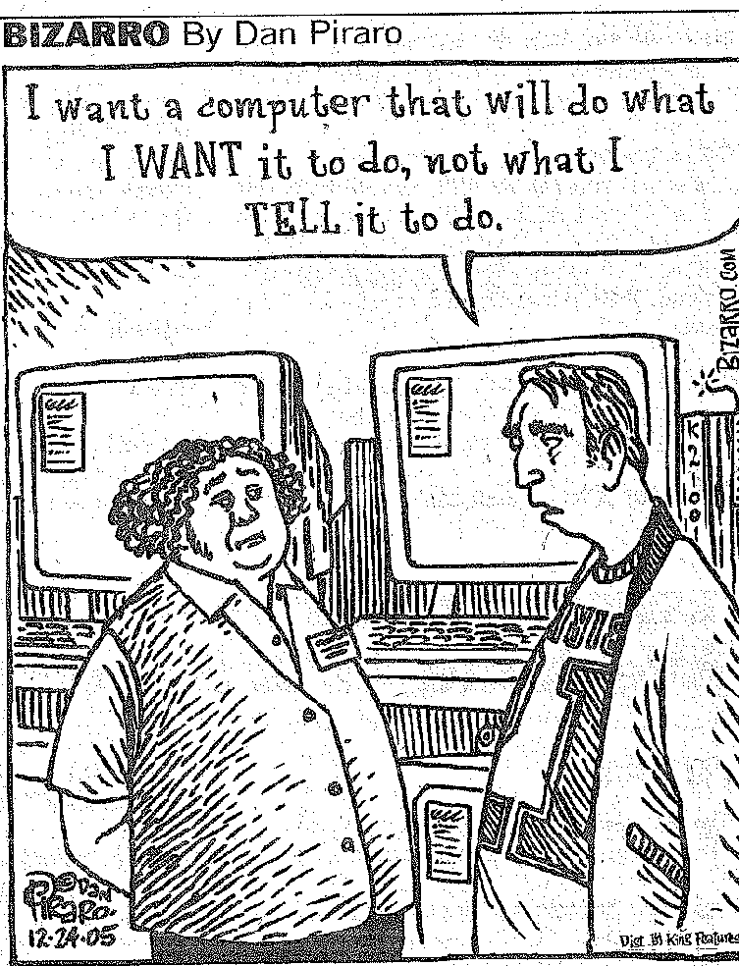
First principles theory and simulation are now at the point where it can drive the design and development of new materials for industry
Nanotechnology, Hydrogen,
Energy, Fuel Cell,
Battery, Water Purification, and CO₂ Sequestration
Technologies
But need to develop new 1st principles based FF to realize these opportunities
Support for MSC activities
DARPA
ONR
ARO
DOE NNSA
DOE BES
DOE FETL
NIH
NSF
DARPA
Chevron
Dow-Corning
Dow Chemical
Ford
Samsung
Sanofi-Aventis
Nestle
SRC-MARCO-FENA

